Slide 1
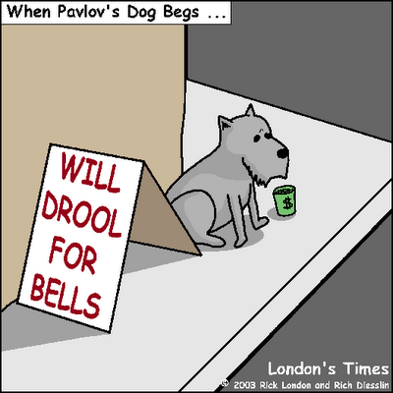
Psychology 4910
Chapter 9
Behaviourism

Slide 2
Behavioursim
One of the most dominant approaches in psychology
Regard behaviour as the only appropriate subject matter for psychology
  Rejected subjective experience as legitimate topic
Extended work of Thorndike and others on animal behaviour
  Rejected introspection as a method; relied on observation instead

Slide 3
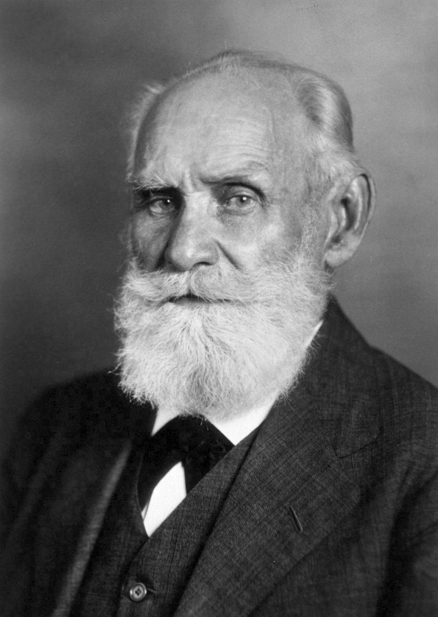
Ivan Pavlov (1849-1936)
1904: Awarded Nobel Prize
  Work on physiology of digestive system
  Subsequently famous for conditioned reflexes
Pavlov dissociated himself from psychology of the time
  Regarded his approach as a blend of the study of behaviour and physiology

Slide 4
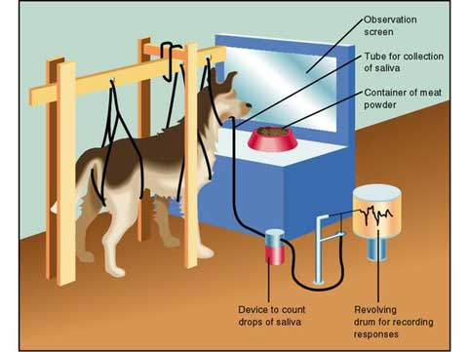
Conditioned Reflexes
Unconditioned reflexes (the same response always occurs in the presence of the same stimulus)
  Unconditioned stimulus
  Unconditioned response
Conditioned reflexes (occur under certain conditions)
  Conditioned stimulus
  Conditioned response

Slide 5
Conditioned Reflexes
Conditioned response is usually smaller in magnitude than an unconditioned one
Extinction: The CR will eventually cease if the CS is repeatedly presented alone
Spontaneous recovery: A previously extinguished CR may return after a period of rest

Slide 6
Conditioned Reflexes
Unconditioned reflexes are not sufficient for survival
  e.g., animal not only has to eat, it has to find food source
Conditioned stimuli are signals that guide animals to unconditioned stimuli

Slide 7
Temperaments and Pscyhopathology
Fundamental cortical processes:
  Excitation
  Inhibition
Temperaments arranged on a scale:
  Choleric (extremely excitatory)
  Sanguine
  Phlegmatic
  Melancholic (extremely inhibitory)

Slide 8
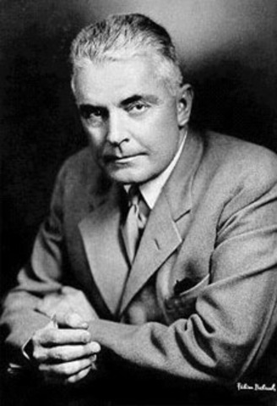
John B. Watson (1878-1958)
1899: Graduated from Furman University
Graduate student at University of Chicago
  Impressed by Jacques Loeb
  1903: Doctoral dissertation in animal psychology
1908: Faculty at Johns Hopkins University
  Quickly became Department head as a result of Baldwin’s bawdy house visit

Slide 9
Psychology as the Behaviorist Views It
1913: Challenged psychologists to change virtually every aspect of their discipline
  Not a study of consciousness
  Study human behaviour in same way as animal behaviour
  Replace unreliable introspection with reliable observation of behaviour
  Reject functionalist psychology
  Focus on prediction and control

Slide 10
Emotional, Manual, and Verbal Habits
Behaviorism (1939): Humans are unique because of the variety of habits they can form through conditioning
Visceral (emotional) habits
Manual habits
Laryngeal (verbal) habits

Slide 11
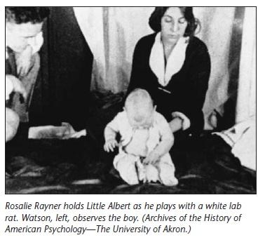
Emotional Habits
Should study emotion via young children
Humans have three innate (unlearned) emotional responses: fear, rage, love
Little Albert study
  Produced conditioned emotional reactions in 11-month-old infant
  Paired aversive sounds with sight of white rat to condition fear
  Conditioned response generalized to other white, furry objects

Slide 12
Manual Habits
Entire range of muscular responses
Manual habits form through repetition
  Formation permits smooth transition from one situation to the next
Watson advocated:
  Formation of early work habits in youth
  Distributed practice to acquire skills (vs. massed practice)

Slide 13
Verbal Habits
Thought verbal habits were the same as internal speech
Verbal habits constitute thinking
  e.g., young children talk out loud, even when they are alone
  Socialization teaches children to think in their heads
Speech is serially-ordered behaviour
  Help us perform complex tasks in the correct sequence

Slide 14
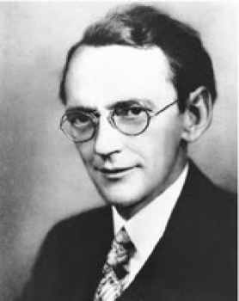
Karl S. Lashley (1890-1958)
Undergraduate at University of West Virginia
PhD at Johns Hopkins University
  Under Herbert S. Jennings
Postdoctoral studies with Watson
  Considered himself a behaviourist; diverged from Watson later in career

Slide 15
Cortical Localization of Function
1916: Lashley studied with Shepherd Ivory Franz
  Ablation: Technique by which parts of cortex are destroyed and the results observed
  Studied effects of ablation on frontal lobes in rats
1917: Moved to University of Minnesota

Slide 16
The Problem of Serial Order in Behavior
Criticized Watson’s associative chain theory
Argued that animals are not always engaging in serially ordered acts
Thought associative chain theory failed to account for:
  Priming of responses
  Spoonerisms

Slide 17
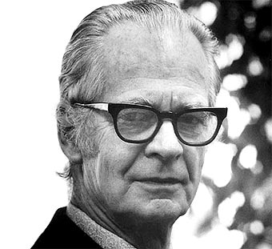
B. F. Skinner (1904-1990)
“. . . behavior which seemed to be the product of mental activity could be explained in other ways.”
Consciousness = A form of behaviour
  Unscientific to think of humans as having minds that control behaviour
All events are public events; feelings of privacy and self-control are illusory

Slide 18
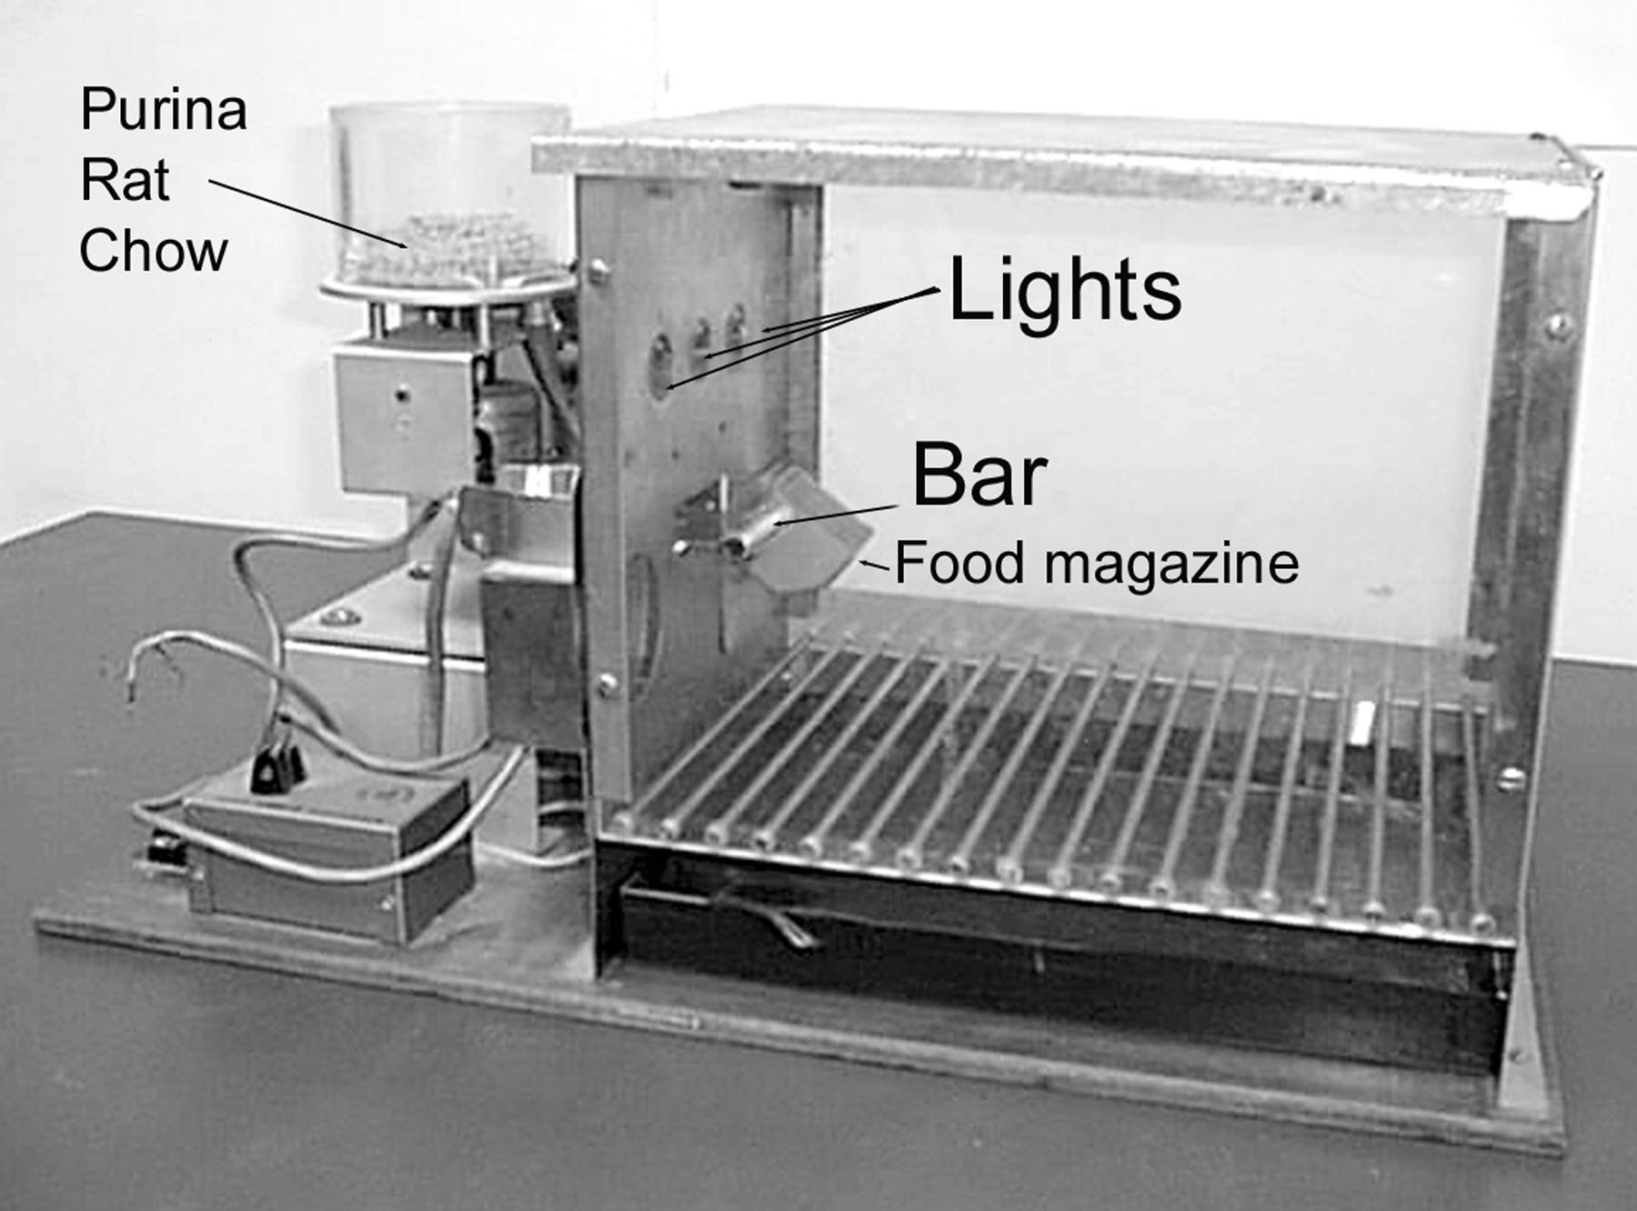
The Behavior of Organisms
Published in 1938: Distinguished between respondent and operant behaviour
  Respondent behaviour: Elicited by known stimulus
  Operant behaviour: No known eliciting stimulus
    Studied by means of a Skinner box
    Food pellet is reinforcing stimulus for pressing lever

Slide 19
The Behavior of Organisms
Behaviour regulated by three-term contingencies
  Environment provides stimulus situation
  → Elicits a response
  → Followed by reinforcing stimulus
    Reward or punishment make behaviour more or less probable
  Negative reinforcement ≠ punishment

Slide 20
A Case History in Scientific Method
Discussed the ways in which Skinner made discoveries
  Applied principles of his psychology to his own creativity
  e.g., “When you run into something interesting, drop everything else and study it”
  e.g., “Apparatuses sometimes break down”

Slide 21
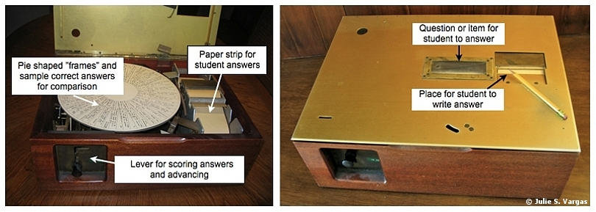
Teaching Machines
Typical classroom: Reinforcement only when the child does the work required to avoid punishment
Skinner suggested: Reinforce students for each response in a sequence that gradually builds up
  e.g., Harvard self-instruction rooms
  Provides immediate reinforcement for correct answers

Slide 22
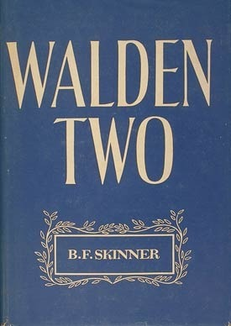
Skinner’s Utopian and Dystopian Views
Walden Two (1948)
  Utopian novel of a community regulated by positive reinforcement
  Received mixed reviews
Skinner increasingly discussed Dystopian features of modern life in the West
  Dystopia: A society that is the opposite of a Utopia

