Slide 1
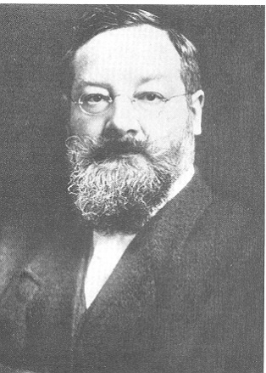
Psychology 4910
Chapter 8
Structure or Function

Slide 2
Edward B. Titchener (1867-1927)
1890–92: Studied with Wundt at Leipzig
Established psychological laboratory at Cornell University, in Ithaca
Utilized a simpler approach than Wundt
Believed “the unconscious” to be fiction
Psychology distinguished from other disciplines by psychologist’s point of view
Need for introspection

Slide 3
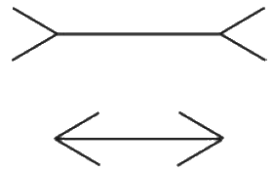

Slide 4
Edward B. Titchener (1867-1927)
Method
Introspection: Process by which individuals describe their experience
Psychophysical parallelism: By referring to events in the nervous system we may be able to explain mental processes without regarding those events as causing mental processes
Psychology = Study of generalized human mind by means of experimental introspection

Slide 5
Structuralism
Aimed to uncover elementary structures of mind
Distinct from structuralism of Piaget
Biology analogy
Biology has structural and functional parts
Scientists can inquire about structure without looking at function
Examine sensations, images, affection as underlying units/processes

Slide 6
Experimental Psychology
Outlined how a beginner student in experimental psychology could acquire fundamental skills
Psychological experiment consists of introspection or series of introspections made under standard conditions
Students need vocabulary to introspect properly
Avoid stimulus error
Content divided into two parts:
Qualitative
Quantitative

Slide 7
Dimensions of Consciousness
Developed abstract approach to study of consciousness
Shifted focus away from basic elements
Stressed analysis of consciousness in terms of dimensions
Never fully outlined what dimensions of consciousness were or how many there were
Died before producing the great work on the subject that his students expected

Slide 8
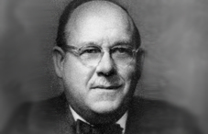
Dimensions of Consciousness
E.G. Boring
Published account of what he considered to be Titchener’s central views
Singled out four dimensions of sensory experience for discussion:
Quality: Variation in basic experiences
Intensity: Strength of an experience
Extensity: Experience can vary across wide area
Protensity: Duration of sensory experience in time

Slide 9
Titchener’s Influence
Little left of the content of Titchener’s system to influence subsequent generations of psychologists
His method of introspection received less and less support
Proposition that psychology was experimental discipline continued to receive widespread support in academic psychology

Slide 10
Functionalism
Set out to violate strictures that Titchener tried to place on psychology
Open to methods other than introspection
Select the method to fit the particular problem
Heavily influenced by Darwin
Foundation of functionalism was theory of evolution
Interested in function that psychological processes serve
Focused on how organisms adapt to their environment

Slide 11
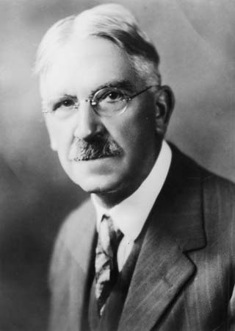
John Dewey (1859-1952)
Wrote a critique of the reflex arc concept.
Paper contains:
Criticism of reflex concept as elementaristic and mechanistic
Suggested that stimulus created by organism through act of paying attention to something
Stimulus responses are not distinct events; mutually influence one another

Slide 12
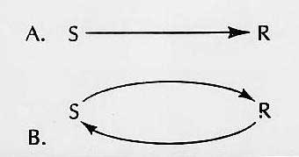

Slide 13
Influence on Educational Practice
Teachers influenced by psychological assumptions they make about children and educational process
Children and adults are different
Adult already possesses cognitive abilities that child is in the process of developing
Argued against teaching the 3 R’s
Challenged “ideal of formal discipline”

Slide 14
Influence on Educational Practice
Did not advocate for progressive education but became associated with it
Teachers had responsibility to provide students with “experiences that are worthwhile”
Teachers should:
Become acquainted with community conditions (historical, economic, occupational)
Connect education with experience
Give children some autonomy over learning experience

Slide 15
Robert S. Woodworth (1869-1962)
Proposed the S-O-R framework
S-O-R
S = Stimulus
R = Response
O = Organism (subject)
W-O-W
O = Organsim
W = World (environment)

Slide 16
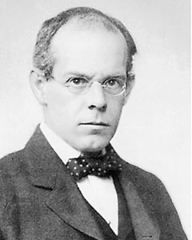
Intelligence Testing
Functionalism created climate in America within which applied psychology could flourish
Emergence of intelligence test
One of the best examples of the application of psychological methods to practical problems
James Cattell (1860-1944) introduced the term mental test
His test lacked validity and did not correlate with academic performance.

Slide 17
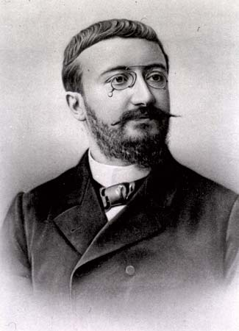
Alfred Binet (1857-1911)
Invented most influential form of intelligence test
Collaborated with Theophile Simon
Discriminated between normal and subnormally intelligent children
Allowed children of subnormal intelligence to be understood in psychological terms
Determined that “slow” children belonged in special ed classes, not hospitals
Redefined intelligence as psychological dimension

Slide 18
Alfred Binet (1857-1911)
The Binet-Simon Scale
1904: Minister of Public Instruction created Commission on instruction of “defective” children
Binet and Simon defined intelligence in functional terms, as “practical sense”
Consists of reasoning and comprehension
Allows children to be compared in terms of mental age
Determined by age level of items a child can pass

Slide 19
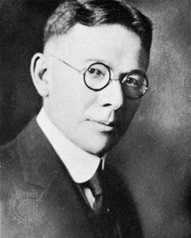
Lewis M. Terman and the Standford Binet
Lewis M. Terman
Developed the most successful adaptation of Binet-Simon scale in American context
Innovation of intelligence quotient, or IQ
William Stern
IQ obtained by dividing person’s mental age (MA) by his/her chronological age (CA)

Slide 20
Intelligence Testing in the US Army
Culturally-biased
Items required basic knowledge of American history
National differences in intelligence
Interpreted as innate racial differences
Used as justification for Immigration Act of 1924 (excluded immigrants from southern and eastern Europe)
Racial differences in intelligence
Truly reflected education disadvantage of Blacks from southern states

Slide 21
What is Intelligence
Acquired? Innate?
Binet: Viewed intelligence as collection of different skills
Boring: Viewed intelligence as capacity to do well on intelligence test
After WWII, intelligence test become embedded in American culture
Scholastic Aptitude Test
Definition of intelligence has changed more than intelligence tests have

Slide 22
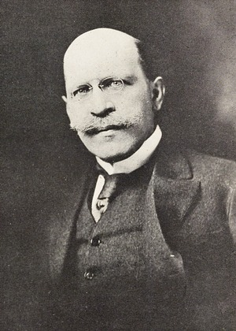
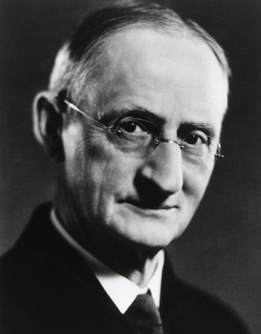
Psychology in Business
Application of psychology to problems of interest to business
Hugo Münsterberger
Psychology and law
Psychology in industry
Walter Dill Scott
Developed mental tests for businesses

Slide 23
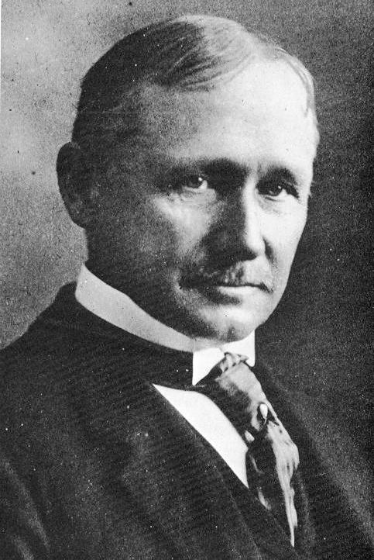
Frederick W. Taylor (1856-1915)
Lifetime focus on efficiency
Scientific management
e.g., Bethlehem Steel Company
Increase output of individual workers, decrease total number of workers
Methods developed by Frank and Lillian Gilbreth
Time and motion study
Instantaneous photography
“Micromotion” pictures to train workers on the best way to do their jobs

Slide 24
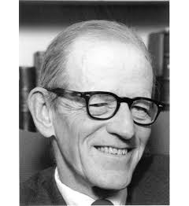
Elton Mayo (1880-1949)
1926: National Research Council studied effect of changes in lighting on workers’ output at Western Electric Plant in Hawthorne, IL
Mayo was part of group called in to investigate
Hawthorne effect: Any change in work conditions increases output
Being watched produced increased output
Work is inherently social activity

Slide 25
Comparative Psychology
Understanding evolution of behaviour through comparison of different species
George John Romanes
Mind = Subject matter
Anthropomorphic; focused on continuity
Criticized for being anecdotal
C. Lloyd Morgan
Experimental approach to study animal behaviour
Canon: Rule that regulates how one should investigate something

Slide 26
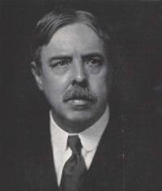
Edward L. Thorndike (1874-1949)
Researched animal intelligence
Puzzle box: Apparatus assembled by Thorndike out of wood
Procedure:
Cat placed in puzzle box with food outside
Cat required to pull on a string and push a latch
Thorndike concluded that cat did not use reason to escape
Law of effect
“The immediate consequence of a mental connection . . . can work back upon it to strengthen it”

