Slide 1
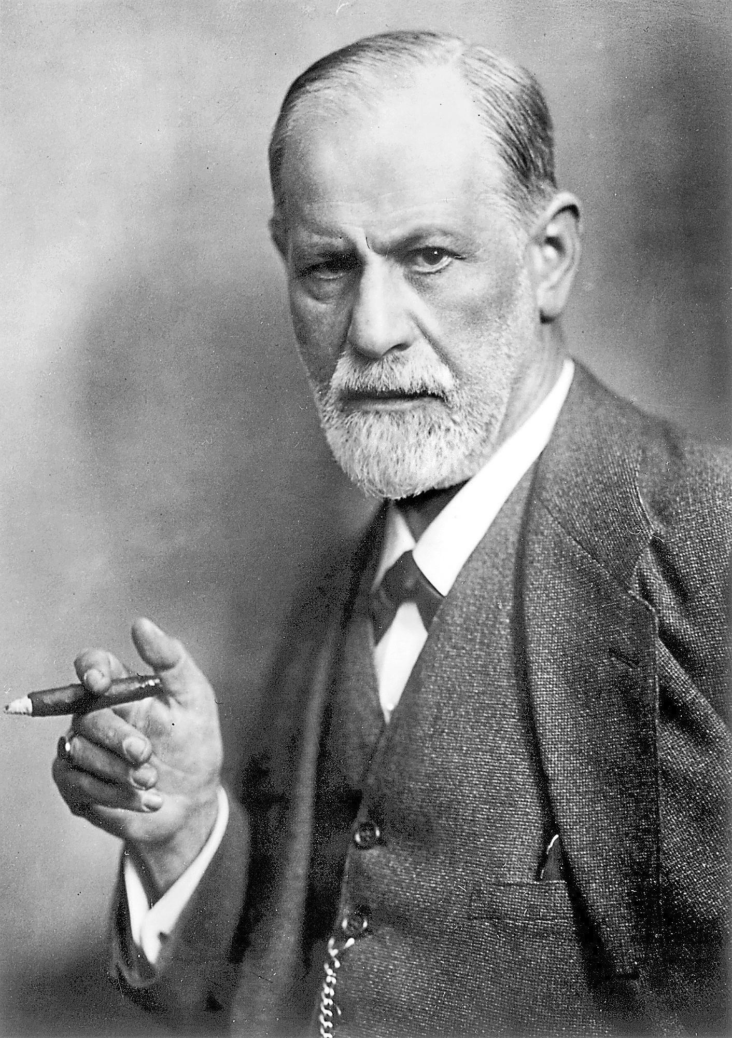
Psychology 4910
Chapter 7
Freud and Jung

Slide 2
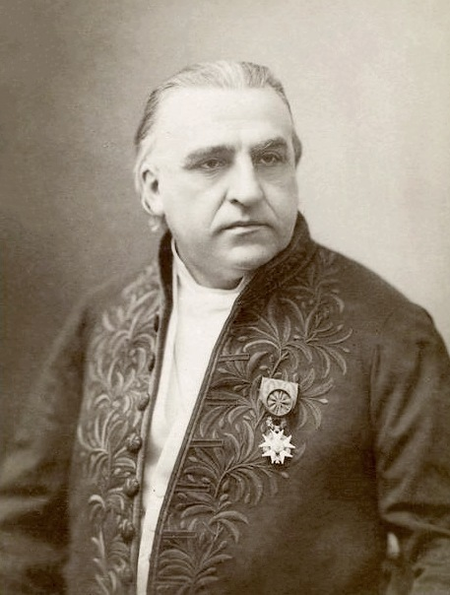
Sigmund Freud (1856-1939)
1885: Went to study in Paris
Studied with Jean-Martin Charcot
Focused on patients with hysteria; long believed to be exclusively a woman’s disease

Slide 3
Hysteria
Conversion Hysteria:Patient has physical symptom, such as paralysis or lack of feeling in a part of the body
e.g., Glove anaesthesia: No sensation in the hand below the wrist
Potential causes?
Neural damage or disorder
Fabrication to avoid work
Unconscious forces (Freud)

Slide 4
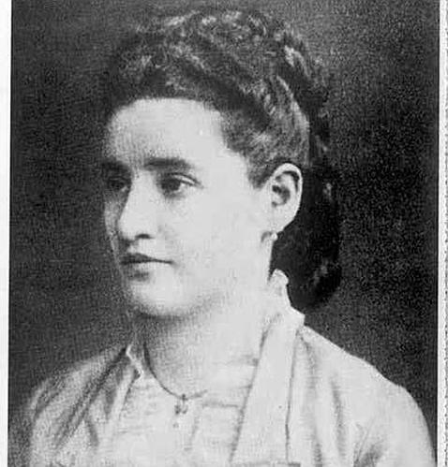
Hysteria
Anna O.
Real name: Bertha Pappenheim
1880: Treated by Joseph Breuer
Symptoms: Paralysis of both legs and right arm
Diagnosis: No physiological explanation; diagnosed as hysteria
Treatment: Hypnosis
Result: Symptoms disappeared if encouraged to talk about them under hypnosis

Slide 5
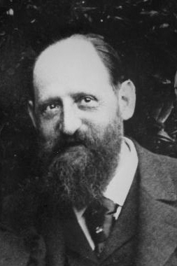
Hysteria
Freud adopted Breuer’s cathartic method; they published an account of it together
Believed that “pent-up affect” can have pathological consequences
Catharsis: Process by which the expression of an emotion removes its pathological effect
Freud eventually abandoned hypnosis because of “awkward” situations it produced

Slide 6
Hysteria
Freud first saw hysterical symptoms as result of early childhood sexual trauma
Based conclusion on cases of 6 men and 12 women
Argued that symptoms were result of repression
Person forgets painful experiences; trace of memory still exists in the unconscious
Unconscious memory is source of pathology

Slide 7
Hysteria
Freud eventually came to believe that patients’ descriptions of sexual abuse were fantasies
Represented infantile wishes on the part of the patients (e.g., Oedipus complex)
Some argue that he tried to cover up abuse after pressure from colleagues
Freud’s repression came to refer to tendency to inhibit unacceptable desires/impulses

Slide 8
Project for a Scientific Psychology
Utilized data from his clinical work to draft preliminary psychoanalytic theory
Tried to explain nature of consciousness in neurological terms
e.g., Apply Newton’s principle of inertia to the nervous system
Nervous system tends to remain at rest unless something forces it to act

Slide 9
Project for a Scientific Psychology
Primary process of nervous system
Discharges energy as it accumulates
Returns nervous system to state of relative inertia
Follows the pleasure principle
Secondary process of nervous system
Inhibits primary processes
Finds ways to gratify wishes in accordance with reality
Follows the reality principle

Slide 10
Project for a Scientific Psychology
Traumatic incident can precipitate use of energy to maintain repressed memories
Accumulation of energy → Hysterical symptoms
Cathexis: Process by which we become attached to activities that will gratify our wishes
Countercathexis: Process by which we give up such attachments

Slide 11
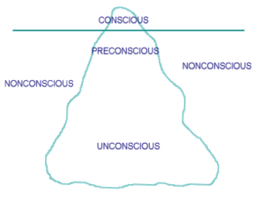
The Interpretation of Dreams
Dynamic Model
Represented by a triangle
Top = Conscious system
Contains all those things of which we are aware
Middle = Preconscious system
Contains all those things of which we are not now aware but of which we could become aware
Bottom = Unconscious system
Contains those things of which we are not aware and cannot directly become aware

Slide 12
The Interpretation of Dreams
When an adult dreams, regression occurs
“Returning” or “going back to”
Movement from mature/complex function of thought to lower level of dreaming/hallucination
Dreams = Outcome of regressed state in which unconscious wishes can avoid censorship
Dream interpretation can decode unconscious wish

Slide 13
The Interpretation of Dreams
Manifest content: What we experience when we dream
Latent content: What we discover by analyzing a dream
Free association: Procedure by which patient begins by thinking about a dream and then saying whatever comes to mind without censoring
Dream interpretation is not mechanical process
Must be interpreted within context of patient’s life

Slide 14
The Development of Personality
Freud believed that sexual urges dominate development from beginning of life
In early life, libido is centered around one’s own body rather than sexual intercourse
Psychosexual stages:
Oral stage
Anal stage
Phallic stage
Genital stage
Risk of fixation at each stage

Slide 15
The Development of Personality
Attachment
We do not give up attachment unless we must
If child survives to adulthood, at least some wishes must have been gratified
Person may regress to earlier stages
Events like death of spouse may push adults to return to childhood sources of gratification
Successful development means forming new attachments

Slide 16
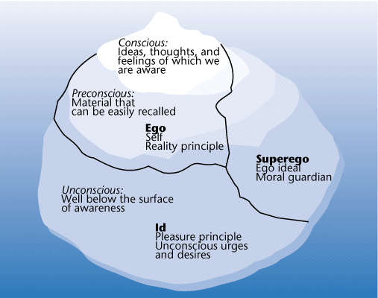
The Structure of Personality
Id
Dark, inaccessible, striving to satisfy needs
Neurotic anxiety
Ego
Tries to balance id and superego, achieve harmony
Realistic anxiety
Superego
Standards imposed on us by society
Moral anxiety

Slide 17
Religion and Culture
Freud: We are governed by two instincts
Life instinct (Eros): Constructive
Death instinct (Thanatos): Destructive
Believed that Thanatos explained carnage of WWI
Few of Freud’s own followers (and fewer non-psychoanalysts) accepted hypothesis of death instinct

Slide 18
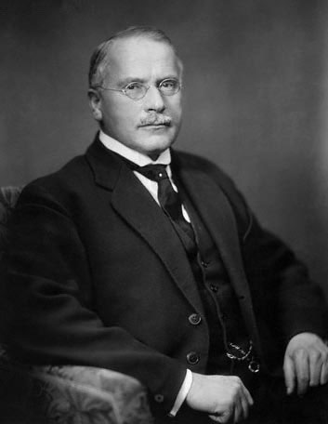
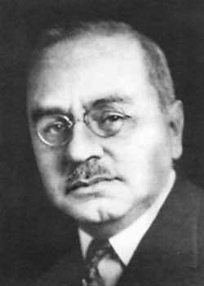
Freud’s Critics within Psychoanalysis
C.G. Jung
Founded his own version of psychoanalysis
Alfred Adler (1870–1937)
Uncomfortable with Freud’s over-emphasis of sexuality
Emphasized role of feelings of inferiority
Centrality of power = Key determinant of behaviour
Believed that birth order was important

Slide 19
Freud and Women
Persistent criticism is that Freud was a misogynist
Espoused largely male-centered psychology
Did not directly address differences between men and women until 1923
Penis envy: Women want to have penis and feel incomplete without one

Slide 20
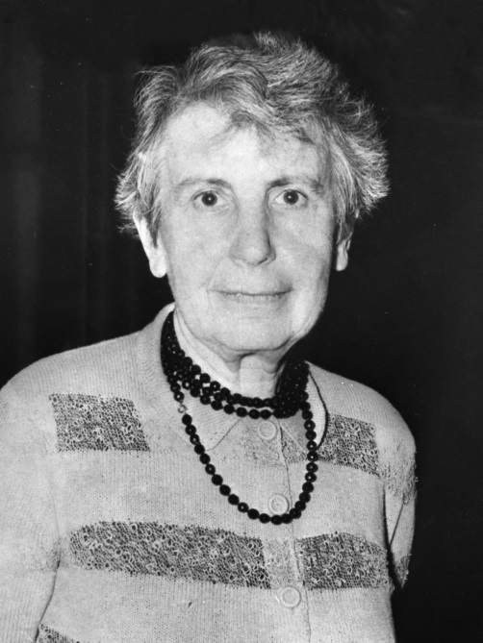
Anna Freud (1895-1982)
Freud’s daughter, secretary, nurse, etc.
Elaborated on defence mechanisms:
Displacement: Redirect impulse toward safer target
Projection: Attribute one’s unacknowledged wish to someone else
Rationalization: Make excuses for behaviour when it violates ego’s conception of itself
Reaction formation: Express the opposite of what you really feel

Slide 21
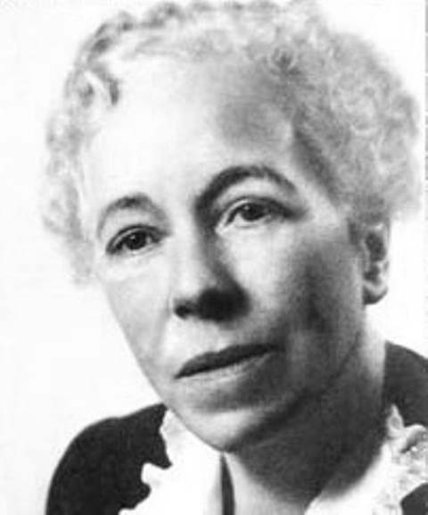
Karen Horney (1885-1952)
First woman to start independent psychoanalytic society (American Institute for Psychoanalysis)
Contributed theories on neurosis, personality development, psychology of women
Argued that neurosis was outcome of child’s response to basic anxiety
Child deals with this in three ways:
Moving towards people
Moving away from people
Moving against people

Slide 22
Carl Jung (1875-1961)
Trained as a physician
Began writing to Freud after reading The Interpretation of Dreams
Visited Freud in Vienna in 1907; became close friends
Accompanied Freud to US in 1909
Lecture focused on technique of word association

Slide 23
Carl Jung (1875-1961)
Jung proposed changes to Freud’s ideas of libido
Freud felt that Jung disowned central parts of psychoanalytic theory
Freud saw libido as sexual energy
Thought modifications stripped psychoanalysis of core ideas
Jung wanted to desexualize concept of libido; expand it
Psychic energy: “Life force” of a person

Slide 24
Analytical Psychology
Jung left psychoanalytic movement
Founded his own theoretical school: Analytical psychology (later called archetypal psychology)
Wrote Psychological Types (1921)
Introversion vs. extraversion
Opposing tendencies
Ways in which different people relate to the world
Introvert = More subjective
Extravert = More objective

Slide 25
Analytical Psychology
Collective unconscious: Characteristics possessed by species as a whole
Detached from the personal; limitless
Personal unconscious: Analogous to Freud’s concept of the unconscious
Repressed memories and ideas, not ripe for consciousness

Slide 26
Analytical Psychology
Archetypes
Exploration of collective unconscious reveals existence of archetypes
Archetype: “The pattern from which copies are made”
Anima: Masculine image of femininity
Animus: Feminine image of masculinity
Persona: One’s public self

Slide 27
Analytical Psychology
Balancing Opposites
Goal is to balance opposing tendencies within yourself
Jung proposed union of opposites as basic process
Drew on Taoism and medieval alchemy

Slide 28
Analytical Psychology
The Four Functions
Perceptual functions: Sensation and intuition
Judgmental functions: Thinking and feeling
Person usually specializes in one of the functions; the other remains primitive
Jung’s typology became popular measure of individual differences

Slide 29
Analytical Psychology
The Collective Unconscious and the External World
Jung sometimes called the collective unconscious the objective unconscious
It is relatively neutral with respect to individual ego
Believed that collective unconscious can be rich source of inspiration
Because collective unconscious and external world are part of nature, they share the same reality

Slide 30
Analytical Psychology
Synchronicity
Refers to meaningful choices
Used to explain events that seem to be connected to one another but are not causally related
Jung rejected notion of coincidences
Events are connected in non-causal way through collective unconscious

