Slide 1
Last Class
Wundt: Völkerpsychologie; psychological processes are affected by culture; must take culture into account
Used for racial psychology
Ebbinghaus: Studied memory using nonsense syllables
2,300 syllables, very controlled – metronome
Forgetting Curve; remote associations
Calkins: Used paired associate method
Studied the effect of frequency
Emphasized the study of the self
Brentano: Mental phenomena – mental acts
Physical phenomena – appear to the imagination
Stumpf and Husserl: Passive observation directed inwards
Würzburg School: Oswald Külpe
Retrospection – Imageless thoughts

Slide 2
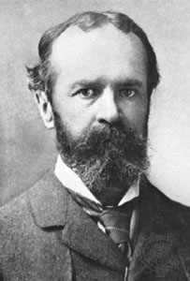
Psychology 4910
Chapter 6
William James

Slide 3
William James (1842-1910)
1861–69: Studied at Harvard
Studied chemistry, then medicine
1872: Taught physiology at Harvard
Considered the most eminent American psychologist of all-time
Second to Wundt on the all-time most eminent psychologists list

Slide 4
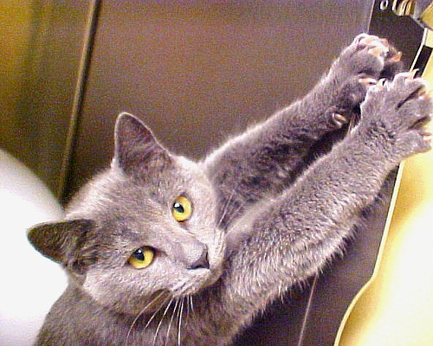
The Principles of Psychology
Sought to simplify the concept of the mind
People are largely creatures of habit
Formation of habits depends on plasticity
Ability of an organism to alter its behaviour as circumstances change
Habit = “the great flywheel of society”
Socially conservative force
Formed early in life; resistant to change

Slide 5
The Methods and Snares of Psychology
James’s method
Consider every issue in open-minded fashion
Didn’t dismiss any possibility without exploring it
Introspection: “Looking into our own minds and reporting what we there discover”
Not perfect; readily prone to error
Indispensable source of data
Seen as a precursor to phenomenology

Slide 6
The Methods and Snares of Psychology
Phenomenology
James did not impose a prior set of categories on experience
Observe and let experience dictate categories
Psychologist’s fallacy: Confusing one’s own standpoint with that of the mental fact about which one is making a report
Psychology = A natural science
The mind is just like every other object in the natural world

Slide 7
The Methods and Snares of Psychology
James’s methods
Not an experimentalist himself
Acknowledged value of experimental and comparative methods
Metaphors were characteristic aspect of James’s methods
Not just a literary device
Convey overall complexity without necessarily specifying precision
e.g., the stream of thought

Slide 8
The Stream of Thought
“Thought” = All of our experiences, not just intellectual events
Later renamed “stream of consciousness”
vs. “train of thought” or “chain of thought”

Slide 9
Stream of Consciousness
Characteristics:
“Every thought tends to be part of a personal consciousness”
“With each personal consciousness thought is always changing”
“Within each personal consciousness thought is sensibly continuous”

Slide 10
Stream of Consciousness
“Consciousness always appears to deal with objects independent of itself”
5. “It is interested in some parts of these objects to the exclusion of others, and welcomes or rejects all the while”

Slide 11
Stream of Consciousness
Places where stream flows at different rates:
Substantive parts: Places were the stream flows slowly
Transitive parts: Places where the stream flows quickly
Language is better suited to describing substantive parts

Slide 12
Stream of Consciousness
Fringe of consciousness
Stream of consciousness does not have a well-defined edge
Difficult to say where it ends and begins
James discussed events beyond the fringe of consciousness
Tip-of-the-tongue phenomenon

Slide 13
The Consciousness of Self
Self divided into two parts:
I: knows things, including oneself (= pure ego)
Me: What I know about myself (= empirical self)

Slide 14
The Pure Ego
Can we say anything about a self that exists over and above our experiences?
Sense of personal identity based on resemblance of experiences
James’s conclusion:
There is nothing of the pure ego we can observe
If it exists, pure ego cannot observe itself
Empirical self is the only one about which we have direct knowledge

Slide 15
The Empirical Self
Divided into three parts:
The material self (= All those things you would call yours)
The social self (= Tied to occasions when other people recognize us)
The spiritual self (= A person’s inner or subjective being [≠ Soul])

Slide 16
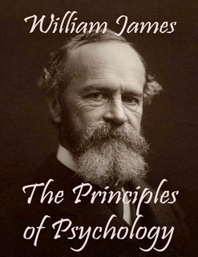
Attention
James’s Descriptions of attention still cited by theorists 100 years after publication of Principles
Appreciated complexity of attention
Inattention: The process by which we do not pay attention to what we are doing
Very common
e.g., automatic writing

Slide 17
Memory
Primary memory: Of the present moment (= immediate memory)
Tends to be quickly forgotten without rehearsal
Permits us to recall recent experiences immediately and accurately
Secondary memory: Of the past
Knowledge of former state of mind after it has left consciousness

Slide 18
Emotions
James-Lange theory of emotions
Similar viewpoint advanced independently by C.G. Lange
Theory appears to have been systematically misinterpreted for decades
Emotion without bodily sensation is not emotion worthy of the name
Bodily perceptions depend on perception of emotion-provoking stimulus

Slide 19
Will
1870: James resolved bout of depression partly by choosing to believe in free will
We cannot freely choose to do anything whatsoever
Will can make a difference when we are in conflict situation
Became preoccupied with will power
Supported self-help movements
Believed that everyone was capable of personal change and self-control

