Slide 1
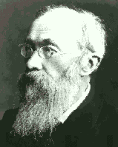
Psychology 4910
Chapter 5
Wundt and His Contemporaries

Slide 2
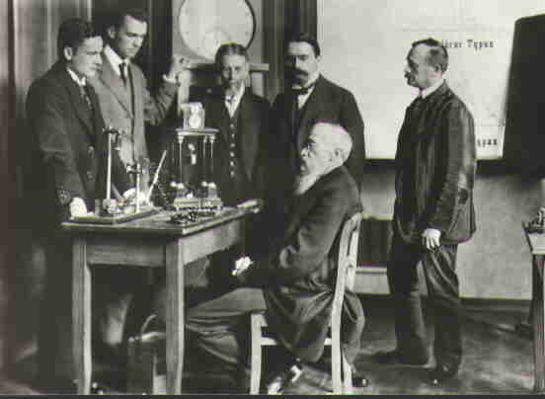
Wilhelm Wundt (1832-1920)
Studied with Müller and Helmholtz
1875: Became a professor at University of Leipzig, Germany
1879: Founded the first laboratory in experimental psychology
Lab attracted many young scholars, including a number of Americans
Ranked most eminent psychologist of all time!

Slide 3
Wilhelm Wundt (1832-1920)
Believed two kinds of methods were necessary for psychology:
Laboratory research suitable only for simple psychological processes
Complex processes influenced by social and cultural factors require naturalistic observation
e.g., ability to use language

Slide 4
Wilhelm Wundt (1832-1920)
Laboratory investigations
Method derived in part from more established disciplines, especially chemistry
Influenced by J.S. Mill’s notion of “mental chemistry”
Mill did not believe mental elements could be discovered through introspection
Wundt believed introspection was appropriate if combined with experimental methods

Slide 5
Wilhelm Wundt (1832-1920)
Made distinction between two types of introspection:
Self-observation: Casually engaged in by everyone
Open to personal bias
Inner perception: Deliberately observing one’s own mental processes
Subjective unless made under controlled conditions

Slide 6
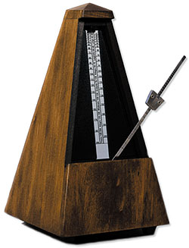
Wilhelm Wundt (1832-1920)
Metronome experiment
Materials: Metronome
Participant:
Not listening to the metronome in the “usual” way (e.g., while playing the piano)
Task is to pay attention carefully to experiences that metronome elicits
Wundt relied on trained participants who knew what to pay attention to

Slide 7
Wilhelm Wundt (1832-1920)
What are participants’ experiences as metronome beats?
Wundt argued that our consciousness is rhythmically disposed
Successive beats have same physical characteristics but different psychological characteristics
Our lives are rhythmically organized (breathing, heartbeat, walking, etc.)

Slide 8
Wilhelm Wundt (1832-1920)
Terminology
Apperception: Process by which we organize and make sense out of our experiences
Creative synthesis: Through apperception, our experiences become a unified whole and not just a series of elementary sensations
Apprehension: Process by which individual impressions enter one’s consciousness
Span of apprehension: How many impressions we could be aware of at one time
Wundt thought this number was 6

Slide 9
The Wundt Curve
Relationship between intensity of a stimulus and its pleasantness
Vertical axis: Degree to which a person feels positive or negative in a particular situation
Pleasantness is a function that rises and then falls as stimulus intensity increases (inverted U shape)
Curve implies that we get the most pleasure from moderate levels of stimulus intensity

Slide 10
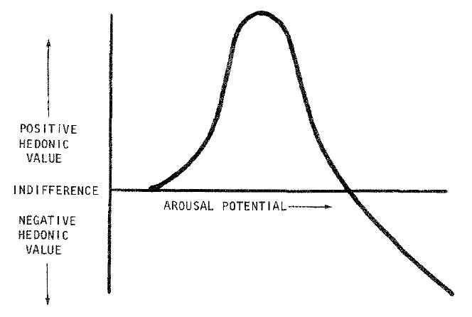

Slide 11
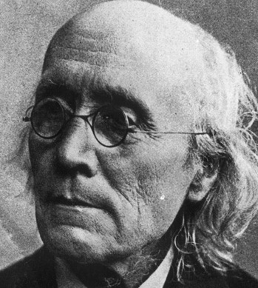
Psychophysical Parallelism
Wundt agreed with Fechner that there is no psychical process which does not run parallel with a physical process
Disagreed with Fechner in idea that there is a point-for-point correspondence between every mental event and every event in nervous system
Mental structures have to be understood in terms of their own laws of combination
Could not be entirely explained by physical events

Slide 12
Cultural-Historical Psychology
Völkerpsychologie: “folk psychology” or “cultural-historical psychology”
Study of the “mental products created by a community of human life”
Rejected idea of studying development of thought in children
Children are byproduct of culture in which they are raised

Slide 13
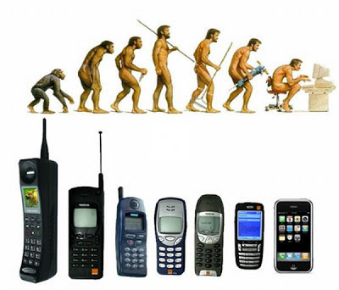
Cultural-Historical Psychology
Wundt wanted to “trace the evolution of mind in man”
We should adopt in psychology the same approach that Darwin had adopted in biology
Interested in language, mythology, and moral systems
Language reflects thinking process
Feeling and volition reflect mythology and moral system, respectively

Slide 14
Wundt’s Influence
Many subsequent psychologists reacted negatively to Wundt’s work
Wundt’s ideas were distorted (e.g., used by Nazi regime to establish racial psychology/hierarchy of cultures)
Now being appreciated for recognition that human mind is product of social and historical forces

Slide 15
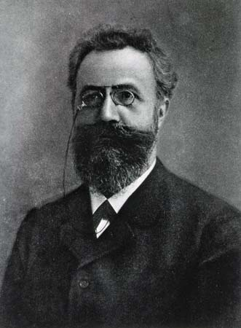
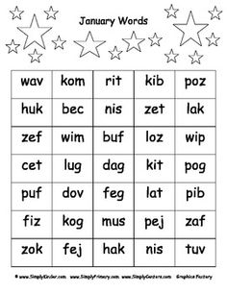
Hermann Ebbinghaus (1850-1909)
Influenced by Fechner’s Elements of Psychophysics
Pioneered use of nonsense syllables
Consonant followed by a vowel followed by a consonant (e.g., “pib,” “wol”)
Benefits of using nonsense syllables:
Relatively meaningless, not influenced by previous learning
Provide quantifiable measure of learning and memory
Number of syllables remembered or number of trials required to learn a list

Slide 16
Hermann Ebbinghaus (1850-1909)
Ebbinghaus acted as his own research participant
Experiments involved constructing lists from a pool of 2,300 nonsense syllables
All 2,300 were used before any were repeated
Process:
Go through list from beginning to end, reading syllables at a rate governed by a metronome (150 beats per minute)

Slide 17
Hermann Ebbinghaus (1850-1909)
Forgetting curve: Summarized how long it took to relearn list of nonsense syllables already memorized
The longer the time since the original learning, the longer it took to relearn the list
Forgetting is greatest immediately after learning
Declined more gradually afterwards
Remote associations: Associations formed between all items in the list, not only between adjacent items

Slide 18
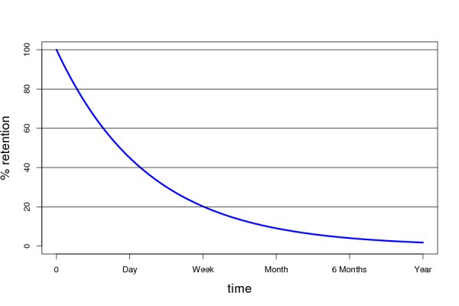

Slide 19
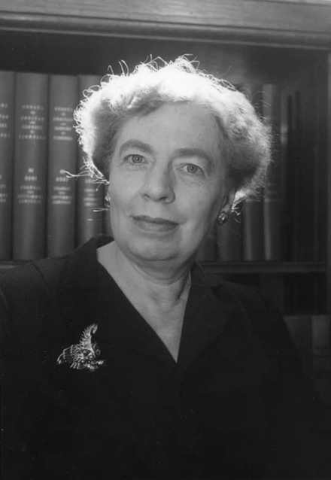
Mary Whiton Calkins (1863-1930)
Developed paired associates method
Participants learned pairs of items
Possible to attempt to determine most influential factors in learning process (e.g., frequency)
Technique became standard method in the study of human learning

Slide 20
Mary Whiton Calkins (1863-1930)
Method
Participant shown list of pairs of items
e.g., different colours paired with different numbers
Participant given one of the members of the pair and asked to give first response that comes to mind
Investigated role of frequency or repetition

Slide 21
Mary Whiton Calkins (1863-1930)
Calkins and the self
Psychology is the study of the self
Argued for a more personal psychology to coexist with traditional impersonal psychology
The Self is:
A totality; one of many characters
A unique being
An identical being
A changing being

Slide 22
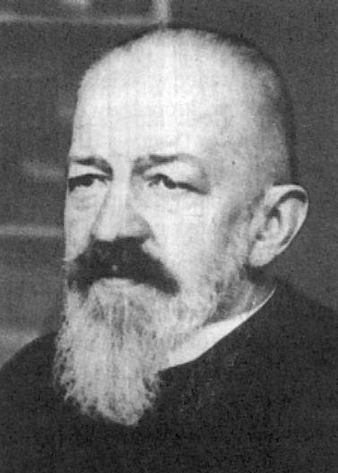
Franz Brentano (1838-1917)
Distinguished between mental phenomena and physical phenomena
Mental phenomena involve mental acts
e.g., hearing a sound
Physical phenomena appear to the imagination
e.g., a musical chord, which I hear

Slide 23
Franz Brentano (1838-1917)
Act psychology
Revisiting metronome experiment, Brentano suggests we focus on the act of listening
vs. Wundt: focus on the experience
Mental acts can be named only by active verb; involve reference to content; are intentional
Classes of mental acts: Ideating (“I see, I hear, I imagine”); Judging (“I acknowledge, I reject”); Loving-Hating (“I feel, I wish, I desire”)

Slide 24
Franz Brentano (1838-1917)
Laid groundwork for phenomenological psychology
Developed by Carl Stumpf and Edmund Husserl
Method: Attempt to describe consciousness as it presents itself to us
Avoid presuppositions as to its nature or purpose
Approach tends not to be experimental
Husserl developed Brentano’s concept of intentionality
By comparing a number of similar experiences, we can intuitively grasp their essential nature

Slide 25
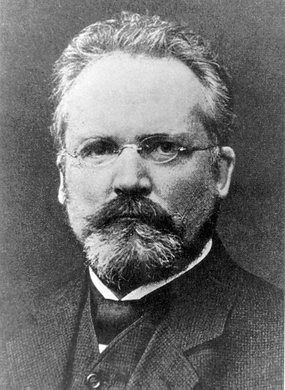
The Würzburg School
Group of psychologists at University of Würzburg, Germany
Studied complex mental processes by means of introspection
Wundt had argued that only simple processes could be studied using introspection
Mentor of the group: Oswald Külpe

Slide 26
The Würzburg School
Systematic experimental introspection
Participants looked back on their experiences after they occurred and described them (retrospection)
Found that mental operations corresponding to certain activities are hard to verbalize (imageless thoughts)
Contradicted Aristotle; argued that all thoughts accompanied by images
Determining tendencies: Give thinking a direction

