Slide 1
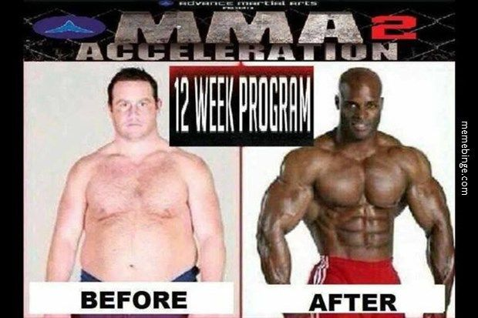
Psychology 4910
The Nineteenth-Century Transformation of Psychology

Slide 2
Psychology in the Nineteenth Century
Beginning of nineteenth century:
Many agreed with Kant that psychology could never be considered a science
End of nineteenth century:
Possibility that psychology could be a scientific discipline seemed more plausible
Green, Shore, and Teo (2001): the “transformation of psychology”

Slide 3
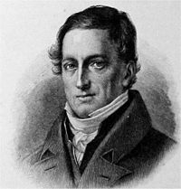
J. F. Herbart (1776-1841)
Believed that mathematics is applicable to psychological events
Often regarded as one of the earliest mathematical psychologists
Interested both in what went on above and below the threshold of consciousness
Events below the threshold of consciousness are unconscious; could become conscious

Slide 4
J. F. Herbart (1776-1841)
Assumed that all mental life is the result of action and interaction of elementary ideas
Elementary ideas: simple concepts or sensations (e.g., red, sour, etc.)
Ideas may be opposed to one another and act like forces upon each other
Inconsistent ideas will tend to reduce the intensity with which each one is experienced

Slide 5
J. F. Herbart (1776-1841)
Some ideas facilitate each other while other ideas inhibit each other
One idea can never push another completely out of awareness
The extent to which one idea can inhibit another can be described in mathematical terms.
Apperceptive mass: The set of ideas that assimilates ideas consistent with it and rejects ideas inconsistent with it
All concepts strive against suppression
This striving for expression in consciousness is the source of the emotions
Herbart’s psychology is dynamic; contents of consciousness in constant flux

Slide 6
J. F. Herbart (1776-1841)
Goal of education is to instill the values of the established order
Steps for instruction:
Preparation
Presentation
Association
Generalization
Fifth step added later: Application

Slide 7
J. F. Herbart (1776-1841)
Herbart’s Contributions to Psychology
Notion that ideas can move back and forth across a threshold of consciousness
Attempt to apply mathematics to psychology
Attempt to apply psychological ideas to the field of education

Slide 8
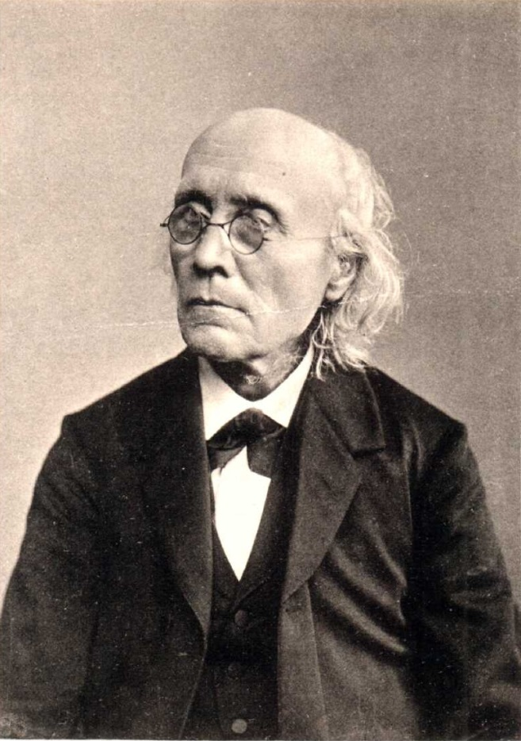
G. T. Fechner (1801-87)
Studied medicine in Leipzig, Germany
Moved into the literary field
Studied physics
Taught physics at University of Leipzig
Responsible for creating an approach to psychology that was seen as truly scientific

Slide 9
G. T. Fechner (1801-87)
Developed mysterious illness that forced him to resign as professor of physics
Started new career looking at how our inner nature is related to our outer nature, exploring:
Relationship between body and soul
Aesthetics
Philosophy of nature

Slide 10
G. T. Fechner (1801-87)
Assumed that there was an intimate relationship between consciousness and events in the nervous system.
Psychophysical parallelism: a strict parallelism exists between soul and body in such a way that one can be constructed from the other.
Outer psychophysics: investigation of the relationship between events in the external world and the experiences to which they give rise.

Slide 11
G. T. Fechner (1801-87)
Fechner came to see a way of expressing the relationship between physical energy and mental activity
How would change in intensity of light in a room impact our experience of that light?
Depends on the magnitude of the original stimulus and magnitude of the change in stimulus

Slide 12
G. T. Fechner (1801-87)
Weber’s Law: The relation between a stimulus magnitude and the amount by which that magnitude must be changed in order for the subject to perceive a just noticeable difference (JND)
Requires that we regard our basic experiences, or sensations, as quantifiable
Quantity objection: a refusal to accept this assumption of psychophysics

Slide 13
G. T. Fechner (1801-87)
Three methods to make psychophysical measurements:
Method of just noticeable differences
Method of right and wrong cases
Method of average error

Slide 14
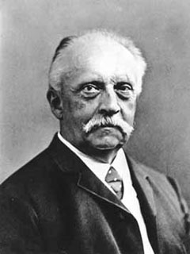
Hermann von Helmholtz (1821-84)
One of the greatest scientists of the 19th century
Could bring the fields of physiology, physics, and mathematics to bear on any one subject
Influenced by Johannes Müller
Advanced a theory called the specific energy of nerves

Slide 15
Hermann von Helmholtz (1821-84)
Elaborated Müller’s view of senses on both physiological and philosophical basis
Formed the foundation of modern sensory neuroscience
Müller:
We do not experience external world directly
We experience changed condition of the nerve fibers = state of excitation or functional activity

Slide 16
Hermann von Helmholtz (1821-84)
Helmholtz:
All nerves operate in the same way and transmit impulses at same speed
Different experiences arise when nerves connect different sense organs to different places in the brain
Compared nerves to telegraph wires: All wires are the same, but each can transmit a unique message from sender to receiver

Slide 17
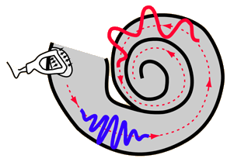
Hermann von Helmholtz (1821-84)
Young-Helmholtz theory of colour perception: The degree to which each cone in the eye is stimulated determines the colour we see
Red, green, and blue are fundamental
also called the trichromatic theory of colour perception
Place theory: Nerves located at different places in the cochlea are responsible for the perception of different pitches

Slide 18
Hermann von Helmholtz (1821-84)
Unconscious inference: We infer, on the basis of previous experience, that particular objects in the world have given rise to the images on our retinas
Result of this process is three-dimensional world we experience
We are unaware of these inferences

Slide 19
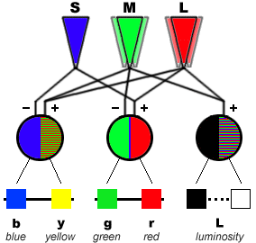
Ewald Hering (1834-1918)
Formulated competing theory to Helmholtz’s theory of colour perception
Opponent process theory of colour vision:
Visual system is based on three pairs of antagonistic processes
Light acts on each pair to yield one of its component colours but inhibit the other
The pairs are yellow-blue, red-green, and white-black

Slide 20
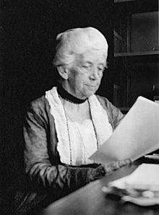
Christine Ladd-Franklin (1847-1930)
Theory of colour perception was evolutionary:
Stage 1: Vision sensitive to achromatic colours (white to black)
Stage 2: Emergence of cones sensitive to yellow and blue
Stage 3: Some cones sensitive to yellow undergo further specialization; become cones sensitive to red and green
Evidence comes from studies of colour blindness
Studied people unable to see red and green but able to see yellow and blue
Law of progressions and pathologies: Last system to evolve is the first to show effects of degeneration

Slide 21
The Localization of Function Controversy
Longstanding controversy over attempts to locate particular psychological functions in the cortex of the brain
Led to the study of:
Phrenology
Brain injuries

Slide 22
The Localization of Function Controversy
Phrenology (promoted by Franz Joseph Gall and J.G. Spurzheim):
Believed the more highly developed a function, the larger it would be
The larger a function, the more it would protrude from the skull
Thus, one could divine a person’s strengths and weaknesses by examining shape of the skull
Phrenological chart represents locations of various psychological functions

Slide 23
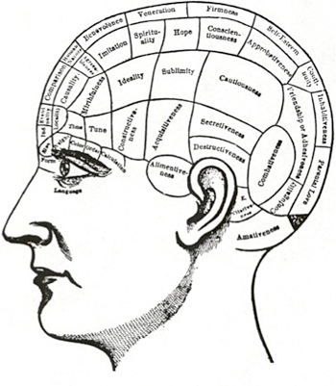
The Localization of Function Controversy

Slide 24
The Localization of Function Controversy
Studies of brain injuries
Brain injuries serve as natural experiments
Provide evidence for location of various psychological functions in the brain
Compare symptoms exhibited to location of brain damage

Slide 25
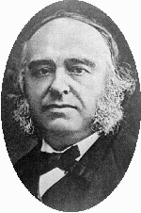
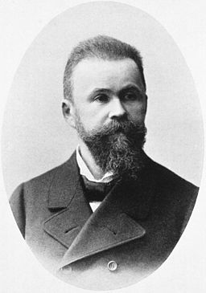
The Localization of Function Controversy
Paul Broca (1824–80)
Investigated loss of ability to express ideas by means of speech (Broca’s aphasia)
Autopsy of patient showed severe damage to part of left hemisphere (Broca’s area)
Karl Wernicke (1848–1905)
Studied patients who could speak but could not understand what was said to them (Wernicke’s aphasia)
Found lesions in the left hemisphere (Wernicke’s area)
Cases are often complex and offer inconclusive evidence

Slide 26
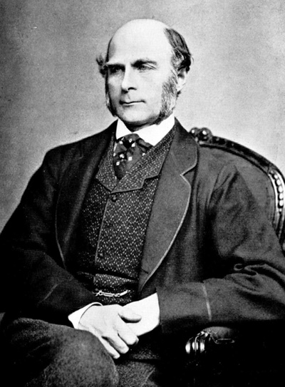
Francis Galton (1822-1911)
Cousin of Charles Darwin.
Developed curiosity about mental peculiarities of different races
Developed hypothesis that ability and genius are hereditary
Sensitized to importance of innate differences through personal failures and limitations
Galton’s law: The two parents contribute one-half of the total heritage of the offspring, the four grandparents one-quarter, etc.

Slide 27
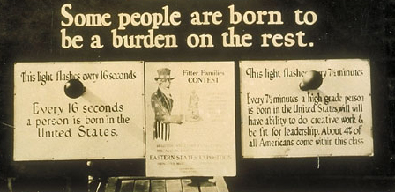
Francis Galton (1822-1911)
Implication of Galton’s studies was that society should encourage selective breeding of humans = eugenics
Eugenic movement became influential in the early twentieth century
Used to justify sterilization of certain ethnic and racial groups
Anti-feminist, opposed birth control for the “finer women”

Slide 28
Francis Galton (1822-1911)
Darwin came to agree with Galton: Future of mankind would depend on intelligence and morality, not fertility
Represented a shift in definition of “fitness” from fecundity to intelligence
Intelligence came to be regarded as one of the most desirable traits

Slide 29
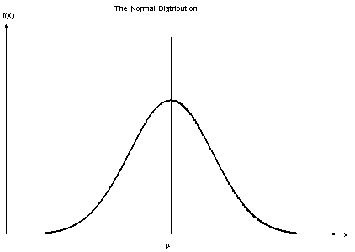
Francis Galton (1822-1911)
Statistics
Helped introduce statistical analysis as important element in psychological inquiry
Normal distribution: Symmetrical distribution, with equal number of events on the left and on the right
Regression towards the mean: Occurs as a mathematical necessity whenever two variables are not perfectly correlated

Slide 30
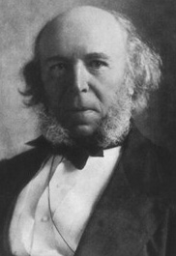
Herbert Spencer (1820-1903)
Coined the phrase “survival of the fittest”
Evolutionary theory applied to the inorganic, organic, and super-organic (i.e., societies)
Law of evolution: Evolution is a process by which a system moves from an indefinite, incoherent homogeneity, to a definite coherent heterogeneity

Slide 31
Herbert Spencer (1820-1903)
Social Darwinism
For Spencer, social evolution and progress amounted to the same thing
Individuals should be left to their own devices
State should not interfere with natural evolutionary process
Some successful American business people took up social Darwinism
e.g., John D. Rockefeller, Andrew Carnegie

