Slide 1
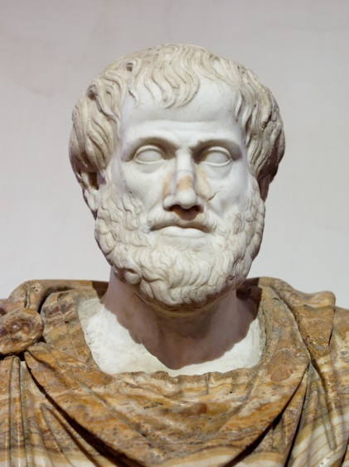
Psychology 4910
Chapter 2
Touchstones: The Origins of Psychological Thought.

Slide 2
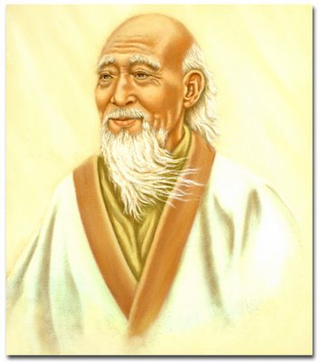
Introduction
Western psychology has its root among the ancient Greeks who speculated about issues such as the relationship between mind and body.
Psychology is not just a Western invention
Eg. Lao-tzu

Slide 3
Pythagoras (570-495 BC)
Realized that reality had an underlying mathematical order.
Eg. Blacksmith hammers
Pythagoras focused on opposites. When the mixture of opposite tendencies is just right, we experience harmony.
Our goal is a state in which the opposing forces within us are properly balanced.

Slide 4
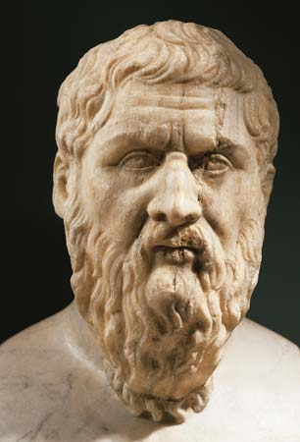
Plato (427 – 347 BC)
Along with Socrates (469-399), Plato pondered whether our traits are innate.
Innate Knowledge: We are in possession of all we need to know to understand fully our experience.
We have the knowledge to solve new problems.
If our deepest and most important ideas are innate, then where did they come from.
The immortal soul.

Slide 5
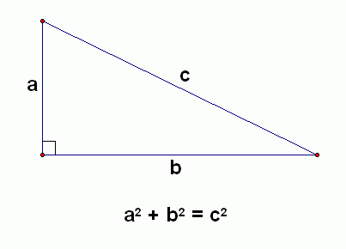

Slide 6
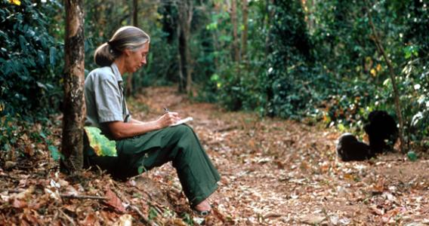
Lao-tzu (6th Century BC)
The wisdom of Lao-tzu is referred as Taoism.
Taoism emphasizes the pervasiveness of change.
It also emphasizes the passive observation of nature.
Similar to scientific observation.

Slide 7
Lao-tzu (6th Century BC)
Scientific observation makes no assumptions about what nature must be, it begins with observations of what actually happens, regardless of theory or dogma.

Slide 8
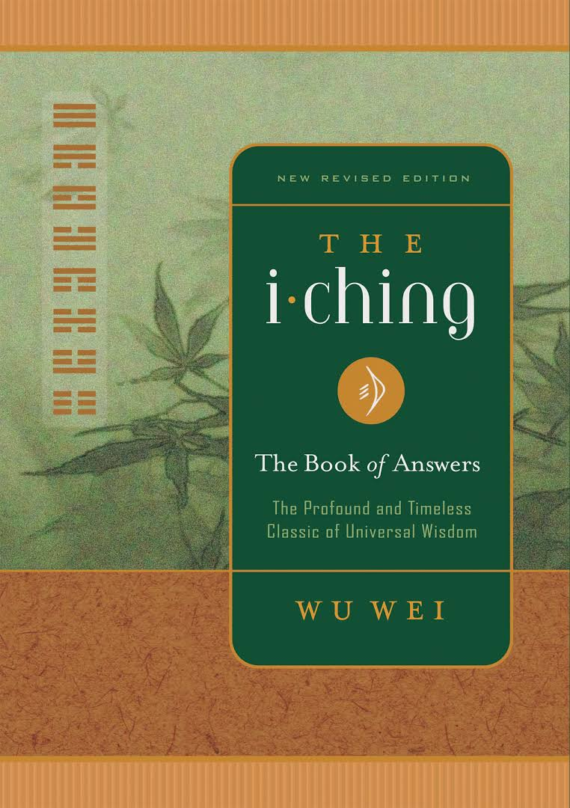
I Ching
Also known as the Book of Changes. It’s an expression of ancient Chinese cultures.
The book introduces the binary system of yin and yang.
Yin represents masculine, firm, and light.
Yang represents feminine, yielding, and dark.
These two powers change in a cyclical fashion.

Slide 9
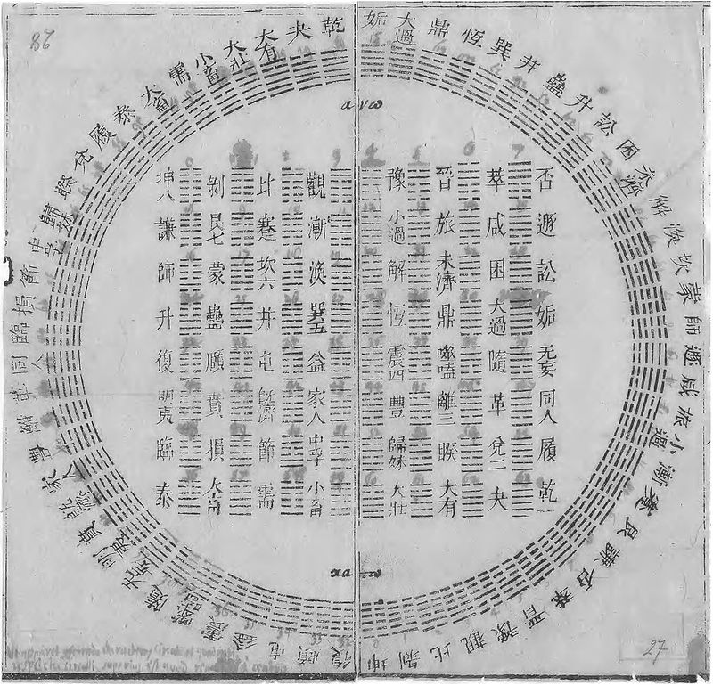
I Ching
This cyclical change is often represented as a circle.

Slide 10
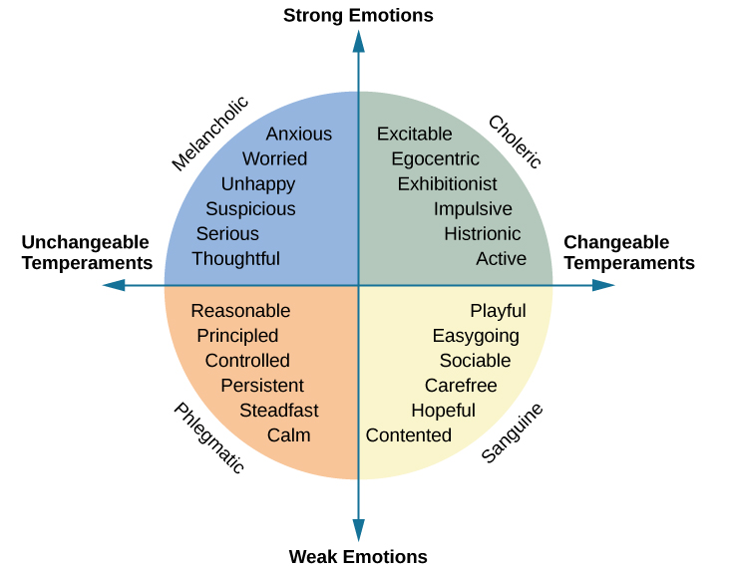
I Ching
Such circular models are important in psychology.
Galen’s typology of temperaments consists of 4 temperaments.
Melancholoic (pessimistic)
Sanguine (sociable)
Choleric (proud)
Phlegmatic (controlled)
These can be arranged in a circle.

Slide 11
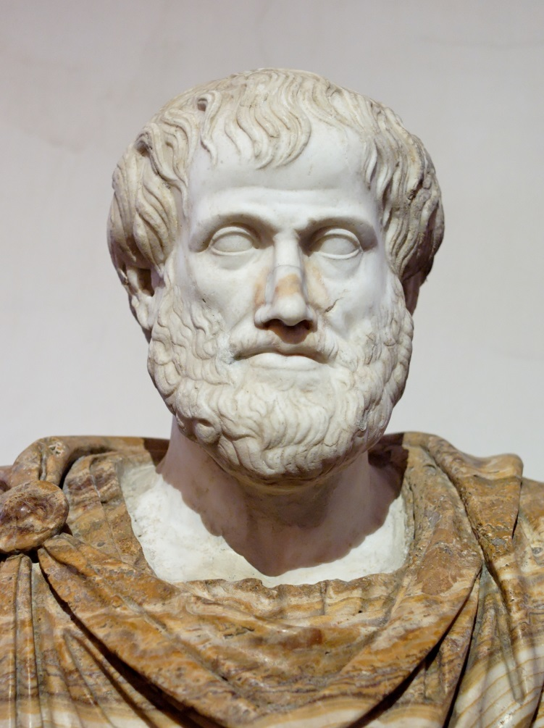
Aristotle (384-323 BC)
Studied with Plato then became tutor to Alexander the Great.
Founded the Lyceum.
He saw the ability to reason as a human attribute that lasts throughout life.

Slide 12
Aristotle (384-323 BC)
Saw human behavior as purposive. We act with certain ends in mind.
He was the first to say that memory is governed by associations.
One idea will follow another if the two were experienced in relation to each other.
When we remember, we follow a chain of associated ideas until we recall what we’re looking for.

Slide 13
Aristotle (384-323 BC)
Aristotle hypothesized that associations are formed on the basis of:
Similarity
Contrast
Contiguity
These make up the first laws of association.

Slide 14
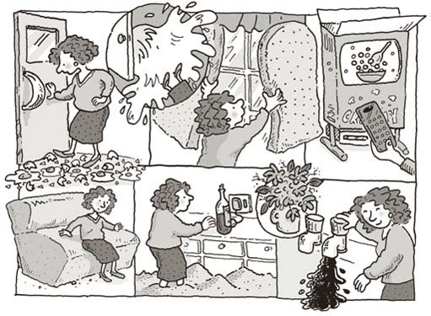
Aristotle (384-323 BC)
These associations have played a role in mnemonics.
Method of Loci: a technique whereby items to be remembered are associated with a series of distinct locations.

