Slide 1
Psychology 4910
Chapter 15
Cognitive Psychology

Slide 2
Introduction
Emerged as a reaction to behaviourism
Post-WWII emergence of information theory and computer science provides a framework for cognitive psychology
Also influenced by Chomsky’s theory of language
Cognitive psychology investigates those processes by which we understand ourselves and our environment

Slide 3
The Concept of Information
Computing machine as information-processing system
Information is the opposite of uncertainty
Any event that reduces or eliminates uncertainty provides us with information
Information theory supplied the vocabulary for a new model of the process of communication
Channel of communication
Encoding/decoding
Inputs/outputs
Signals

Slide 4
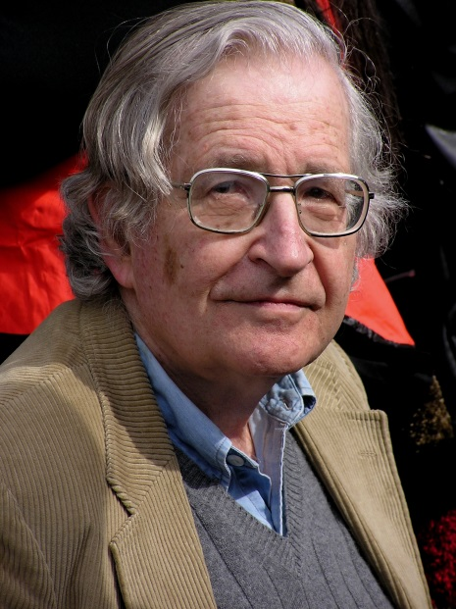
Noam Chomsky (1928-)
Reviewed Skinner’s Verbal Behavior
Argued that behaviourist principles could not explain any significant aspects of language
Any theory of language must explain the fact that natural language is inherently creative
People are continuously generating sentences they have never heard before
Language is not all about stimulus-response
Grammar is independent of meaning

Slide 5
Noam Chomsky (1928-)
Syntactic Structures
Chomsky: Language understood in terms of levels
Surface structure: Level made up by particular words that make a sentence
Spoken one word at a time
Each successive word does not act as a stimulus for the next word in a sentence
Deep structure: Grammatical transformations from which surface structure is derived
Transformations are rules that replace one symbol with another

Slide 6
Noam Chomsky (1928-)
Cartesian Linguistics
Chomsky derived theory from that of Descartes
Descartes:
Human behaviour cannot be understood in a completely mechanical manner
Held nativist belief that our most human capacities are innate
Chomsky:
All languages share principles which are “known unconsciously” by everyone
Children possess language acquisition device

Slide 7
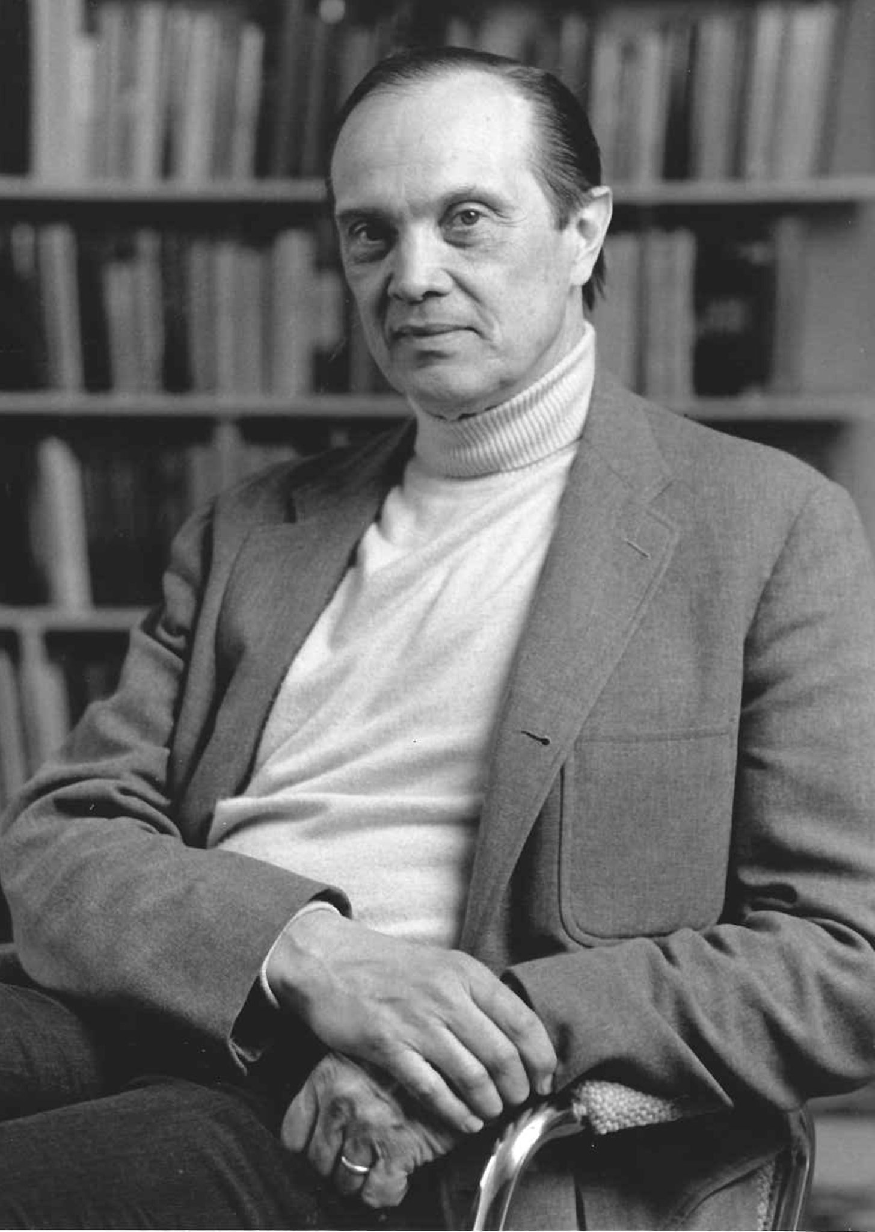
George Miller (1920-2012)
The Magical Number Seven
Channel capacity: How much information can be accurately transmitted through the participant
Span of immediate memory: Amount of information we can hold in the mind at one time
Seven items, plus or minus two
Amount of information we can retain is quite limited

Slide 8
George Miller (1920-2012)
Plans and the Structure of Behavior
Early attempt to give cognitive psychology a coherent theoretical framework
Drew on information theory, Chomskyian psycholinguistics, cybernetics
Feedback loop: Process in which output of one part of a system affects another part, which in turn affects the first part
TOTE mechanisms: Basic unit of behavioural control (test-operate-test-exit)
TOTE units nested within one another to form hierarchies

Slide 9
George Miller (1920-2012)
Subjective Behaviourism
Thinking aloud: Technique used by psychologists interested in studying thought
What people say when asked to think aloud is different from what they say when asked to introspect
Subjective behaviourism
Attempted to balance objective methods of behaviourism with depth of subjective methods

Slide 10
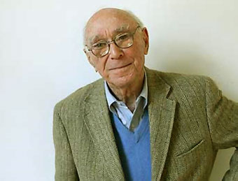
Jerome S. Bruner (1915-)
The New Look in Perception
1940s–50s: “New Look”
Research program in perception
Focused on effects of need, interest, and past experience on manner of organization of perceptual field
Minimax axiom: People organize perceptual field in such a way as to maximize percepts relevant to current needs and expectations
Central axiom

Slide 11
Jerome S. Bruner (1915-)
The New Look in Perception
Events that do not fit our expectancies strike us an incongruous
Perceptual readiness: Degree to which one is prepared to perceive what is in the environment
Criticisms:
Inadequate controls
Too much emphasis on internal, personal determinants of perception

Slide 12
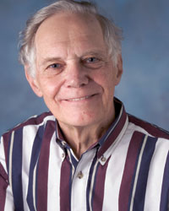
Ulric Neisser (1928-2012)
Cognitive Psychology
Became the “bible of the new psychology”
Illustrates Neisser’s view of relationship between cognitive processes and computer programs
Became standard for most cognitive psychologists
Must be careful not to confuse the program with the computer it controls

Slide 13
Ulric Neisser (1928-2012)
Cognitive Psychology, cont’d
Traced flow of information through organism
Icon → Iconic storage → Pattern recognition → Attention
Reappearance hypothesis: Notion that information is retrieved from memory in the form in which it is stored
Utilization hypothesis: We store traces of earlier cognitive acts, not the products of those acts

Slide 14
Ulric Neisser (1928-2012)
The Influence of Neisser’s Cognitive Psychology
Many treated experimental study of cognitive processes as if they existed in isolation from other psychological processes
Atkinson and Shiffrin model of memory
Sensory register
Short-term store (working memory)
Long-term store

Slide 15
Ulric Neisser (1928-2012)
Cognition and Reality
Neisser turned away from information-processing psychology
Turned towards Gibson’s ecological approach
Ecological validity: Good theory should have something to say about what people do in real, culturally significant situation
Neisser proposed cyclical model of cognition
Begins with schema directing exploration of environment
Person has contact with information
Information corrects the schema

Slide 16
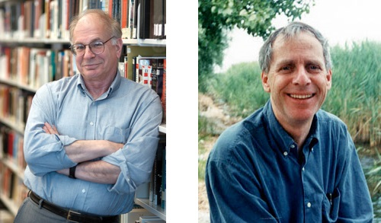
Amos Tversky (1937-96) and Daniel Kahneman (1934-)
Dual process theory in which judgment is the outcome of two distinct systems.
System 1 (Intuition)
System 2 (Reason)

Slide 17
Amos Tversky (1937-96) and Daniel Kahneman (1934-)
Heuristics: Rules of thumb
Biases: Ways in which we are predisposed to make judgments
Effective in some situations but misleading in others
Tversky and Kahneman uncovered several biases associated with particular heuristics

Slide 18
Amos Tversky (1937-96) and Daniel Kahneman (1934-)
Intuitive Statistics
People often rely on intuitive statistics when trying to estimate relative frequency or proportion of times an event will occur
Law of large numbers
Law of averages
Gambler’s fallacy

Slide 19
Amos Tversky (1937-96) and Daniel Kahneman (1934-)
Representativeness and the Belief in the Law of Small Numbers
Law of small numbers
Belief that small sample should be representative of population from which it is drawn
Leads to use of the representativeness heuristic
Lopez: Even those with math training have trouble distinguishing random from non-random processes

Slide 20
Amos Tversky (1937-96) and Daniel Kahneman (1934-)
Adjustment and Anchoring
When people make judgments of the magnitude of something, initial value to which they are exposed will bias their judgment
Discrepancy arises because people adjust estimates depending on starting value of sequence
Judgements are biased by aspects of situation

Slide 21
Amos Tversky (1937-96) and Daniel Kahneman (1934-)
Availability
Plays central role in the way we recall previous experiences
There may be experiences we have had that do not come readily to mind
When things are remembered more easily, we believe there are more of them

