Slide 1
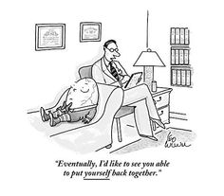
Psychology 4910
Chapter 14
Humanistic Psychology

Slide 2
Humanistic Psychology
Both a movement within academic psychology and an essential part of cultural trends that characterized 1960s
Founders became well-known by general public
Combined European existentialism and American optimism
Distinguished themselves from psychoanalysis and behaviourism
The “Third Force”
Stressed importance of enabling people to reach their full potential

Slide 3
Humanistic Psychology
Existentialism: A doctrine that concentrates on the existence of the individual, who, being free and responsible, is held to be what he/she makes him/herself — OED
Existentialists united by common interest in human freedom

Slide 4
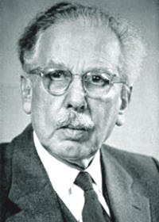
Ludwig Binswanger (1881-1966)
Developed existential approach to psychotherapy; built on Martin Heidegger’s basic ideas
Heidegger was student of Husserl’s; influenced Sartre
Analyzed Dasein, or Being
A person is fundamentally concerned with the fact that he/she is a being-in-the-world
Phenomenological method is the only way to investigate the nature of being-in-the-world
Fear and despair are ways of being-in-the-world

Slide 5
Ludwig Binswanger (1881-1966)
Binswanger originally trained as psychoanalyst; shifted to existential approach
People are spiritual as well as biological creatures
Psychotherapists must attend to the spiritual side of their patients
Must go beyond viewing patient as a biological object
Effective psychotherapy requires total commitment

Slide 6
The Emergence of Humanistic Pscyhology
Convention of the American Psychological Association (1959):
American psychologists believed that existentialism added important dimensions to psychology
American psychologists disagreed with anti-scientific attitude expressed by many European existentialists
In general, the Americans believed that the Europeans had been too pessimistic

Slide 7
The Emergence of Humanistic Pscyhology
First Invitational Conference on Humanistic Psychology (November 1964, Old Saybrook, CT)
Central question: “Can the scientific functions of a humanistic psychological science be set forth?”
Theme:
Be critical of both behaviourist and psychoanalytic approaches to psychology
Both reduce human beings to biological creatures and biological drives

Slide 8
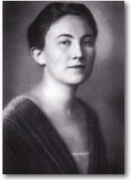
Charlotte Malachowski Bühler (1893-1974)
Central characteristics of humanistic psychology:
Humanistic psychology studies the person as a whole and in relation to the groups to which they belong
A person cannot be understood within a single time frame, but only by considering the person’s entire life history
Intentionality underlies the processes by which a person sets their goals and values

Slide 9
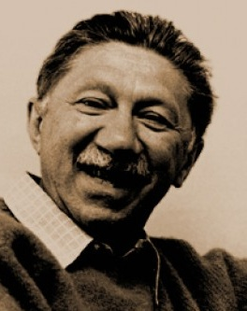
Abraham H. Maslow (1908-1970)
Influenced by anthropologist Ruth Benedict
Synergy: Degree to which needs of individual are consistent with demands of culture
High-synergy culture: Being selfish also promotes the welfare of others
Low-synergy culture: Needs of individual conflict with how culture wants individual to behave
Argued that society should attempt to create synergistic social institutions

Slide 10
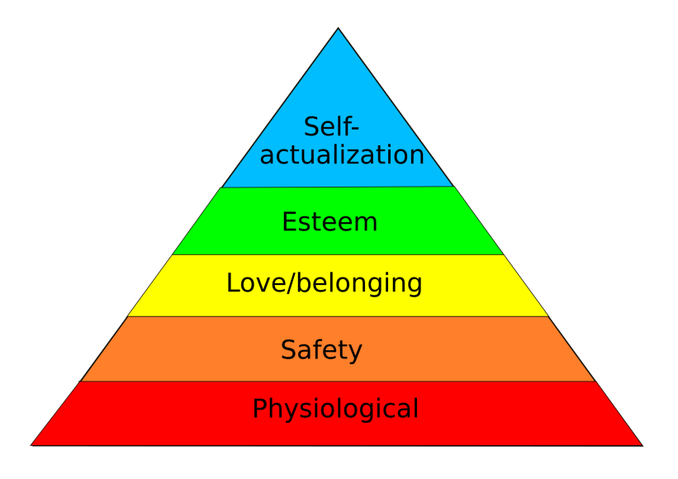
The Heirarchy of Needs
Defined basic needs in terms of their importance to the health of the person
Needs may be organized hierarchically in the order in which they must be satisfied

Slide 11
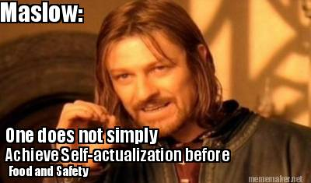
Actualizing Person
If all basic needs are satisfied, a person can move on to self-actualization
Goldstein: “to become everything that one is capable of becoming”
Maslow:
Metamotivations: Motives beyond/above ordinary motives
Deficiency motives: That of which we are deprived
Self-actualizing person has Being values (B-values)

Slide 12
Peak Experiences
Similar to mystical experiences of a oneness with the world
Experience of awe, surrender, of something greater than oneself
Make people aware of centrality of B-values in their lives
Intrinsically valuable
Similar to a childlike way of being-in-the-world
Reduces feeling of alienation from the world

Slide 13
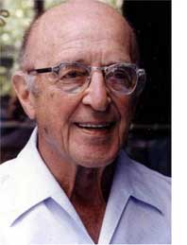
Carl Rogers (1902-1987)
Became synonymous with practice of clinical psychology
Field that seeks to increase our understanding of human behaviour; promote effective functioning of individuals
But practice did not begin with Rogers
Lightner Witmer was first person in the US to define an area called “clinical psychology”
Developed conception of practice while working in schools
1896: Founded the first psychological clinic
Developed courses in clinical psychology

Slide 14
Client-Centred Therapy
Non-directive psychotherapy
Unconditional positive regard: Openness and receptiveness on the part of the therapist
Self-concept: The view a person has of themselves
Ideal self: The way a person wishes to be
Discrepancy between person’s self-concept and ideal self is source of discomfort
Empirically evaluated therapeutic techniques using card sorting technique

Slide 15
What Happened to Humanistic Psychology
Fit well with Zeitgeist of American popular culture in 1960s and 1970s
1970s: Increasing criticism for lack of standards for legitimate forms of therapy
Contributing factor to decline: Leaders moved out of universities
Left theories unstudied
No graduate students
Increasingly conservative culture

Slide 16
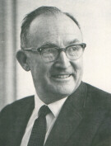
George A. Kelly (1905-67)
Approach shared some characteristics of humanistic psychology but was still distinctive
Explored implications of the notion that people are scientists
“If all people are scientists than the history of scientific thinking is not the history of a few but the history of everyone” (Benjafield, 2008b)

Slide 17
The Psychology of Personal Constructs
People ultimately seek to anticipate real events so that their future reality may be better represented
To predict events, we need to be able to represent them
Constructs: A way in which two events are alike but different from a third event
Personal constructs: Individual ways of noting similarities and differences between events

Slide 18
The Repertory Test
Method of eliciting individual’s personal constructs
Allows one to get an idea of how a person thinks about her or his acquaintances
Participant assigns names of acquaintances who best fit each role title
Each row gives participants a chance to generate their own constructs

