Slide 1
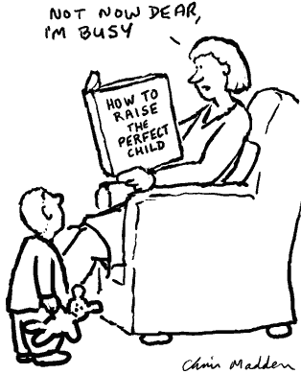
Psychology 4910
Chapter 13
The Developmental
Point of View

Slide 2
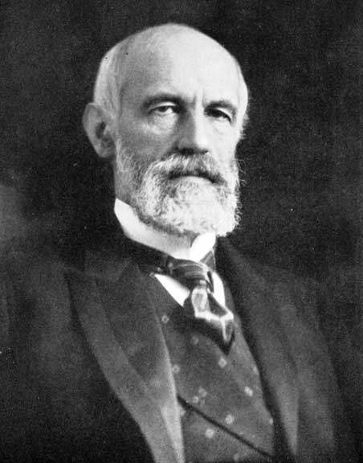
G. Stanley Hall (1844-1924)
The Theory of Recapitulation
E.H. Haeckel = “ontogeny recapitulates phylogeny”
  Ontogeny: Individual development
  Recapitulation: To restate, review, summarize; recurring theme in developmental theory
  Phylogeny: Evolutionary development of a species
Development involves repeating the most important changes in form evolved by our ancestors

Slide 3
G. Stanley Hall (1844-1924)
Gathered data on childhood activities through use of questionnaires
  Found “there is next to nothing of pedagogic value the knowledge of which it is safe to assume at the outset of school life”
  Scope of Hall’s work was enormous; sent out thousands of questionnaires in two years
  Method was taken up by many; the child study movement flourished
    Formed bond between teachers and psychologists

Slide 4
Last Class
D. O. Hebb: Learning theory based on neuropsychology.
  Related learning to neural changes in the brain.
  Cell Assemblies: Neurons that become associated.
  Hebb’s Rule and phantom limbs.
Bandura: Link between clinical and experimental psychology
  Social Learning Theory
  Modelling through observational learning
Mary Cover Jones: Behaviour Modification;
  Systematic Desensitization
G. Stanley Hall
  ontogeny recapitulates phylogeny
  Used questionnaires to gather info on children.

Slide 5
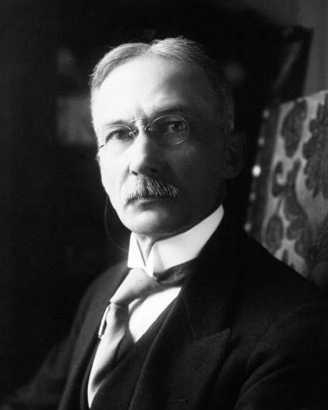
James Mark Baldwin (1861-1934)
Psychology of Mental Development
Development occurs through series of interactions between child and environment
  Assimilation: Tendency to respond to environment in familiar ways
  Accommodation: Tendency to respond to environment in novel ways that changing circumstances may require
  Imitation: Major way in which accommodation takes place; leads to development of new responses

Slide 6
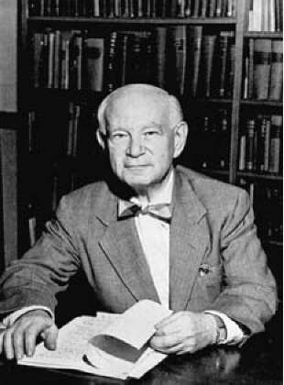
Heinz Werner (1890-1964)
The Comparative Psychology of Mental Development
Best-known work; originally published in German
Approach to psychology was comparative
  Examining the relation between developmental processes in different cultures as well as in different species
Development not restricted to the study of the development of individuals
Orthogenetic principle: Development proceeds from state of globality to state of increasing differentiation

Slide 7
Heinz Werner (1890-1964)
Uniformity versus Multiformity
Uniformity: Behaviour tends to converge from isolated units towards integrated wholes
  Ability of children to identify word meanings as a function of context
Multiformity: Behaviour tends to become increasingly differentiated
  Methods children use to arrive at solutions to problems
Process analysis: Examines in detail and over time the way in which person arrives at particular achievement

Slide 8
Heinz Werner (1890-1964)
Continuity versus Discontinuity
Central issue in developmental psychology
Child’s ability to interact with the world in increasingly differentiated (precise) and integrated (well-organized) way develops smoothly but also shows emergence
  Emergence: Later forms of behaviour have properties not found in earlier forms

Slide 9
Heinz Werner (1890-1964)
Unilinearity versus Multilinearity
Unilinearity: All developmental processes progress in the same way
Multilinearity: Individuals also develop in idiosyncratic ways
  Werner recognized individual differences in development as “specializations” e.g. physiognomic perception.
  Development of distinction between subject (self) and object (world) is central developmental achievement

Slide 10
Heinz Werner (1890-1964)
Fixity versus Mobility
Later developmental levels not to displace earlier ones
As development proceeds, earlier levels become subordinated to later ones
  Organisms attain greater range of operations; these are organized hierarchically, with later forms controlling earlier ones
  Sometimes partial return to earlier modes of functioning can occur (regression, spirality)

Slide 11
Last Class
James Mark Baldwin: interact with the environment
Assimilation and accommodation; imitation
Heinz Werner: orthogenetic principle
Uniformity (word meanings) v. multiformity; process analysis
Continuity (e.g., mobility) v. discontinuity (thinking)
Unilinearity (physical stimuli) v. multilinearity (physiognomic perception)

Slide 12
Heinz Werner (1890-1964)
Microgenesis
Developmental analysis can be extended to phenomena that develop over relatively brief periods of time
  Microgenetic processes
Werner pioneered use of experimental technique to investigate microgenetic processes in perception
  Backward masking technique

Slide 13
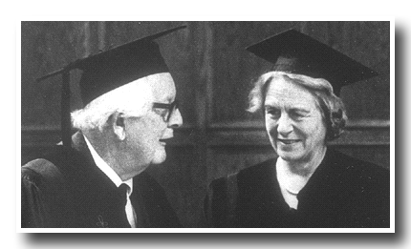
Jean Piaget (1896–1980) and Bärbel Inhelder (1913–97)
The Development of Intelligence
The Origins of Intelligence in Children (1963)
Logical thinking = hallmark of intelligence
  Intelligence is rooted in biological processes
  Adaptation = an invariant function of the organism
Organisms adapt by changing in response to the environment in ways that are not random
  Assimilation and accommodation

Slide 14
Jean Piaget (1896–1980) and Bärbel Inhelder (1913–97)
The Development of Intelligence
The Origins of Intelligence in Children (1963)
Logical thinking = hallmark of intelligence
  Intelligence is rooted in biological processes
  Adaptation = an invariant function of the organism
Organisms adapt by changing in response to the environment in ways that are not random
  Assimilation and accommodation

Slide 15
Jean Piaget (1896–1980) and Bärbel Inhelder (1913–97)
Piaget’s Clinical Method
Clinical method: Open-ended series of questions designed to elicit a child’s viewpoint on the subject of an investigation
Important features:
  Gaining the child’s confidence
  Not appearing to be superior
  Asking questions about all aspects of the matter
  Avoiding suggestions
Criticized by some on grounds of objectivity

Slide 16
Jean Piaget (1896–1980) and Bärbel Inhelder (1913–97)
Stages in the Development of Intelligence
Sensorimotor period (0–2 years)
  Rudimentary interactions; initially, no distinction made between self and other objects
Preoperational period (2–7 years)
  Symbolic play, language, improved memory
Concrete operational period (7–11 years)
  Multiplication of classes
Formal operational period (12 years+)
  Imagine and test various hypotheses about the world

Slide 17
Jean Piaget (1896–1980) and Bärbel Inhelder (1913–97)
Piaget as a Structuralist
Structures must be understood in terms of the way they develop over time
Properties of developing structures:
Wholeness: Structures develop over historical time and within the life individuals
Systems of transformations: Wholeness of structures is not static
Self-regulation: Tendency of structures to become self-regulating

Slide 18
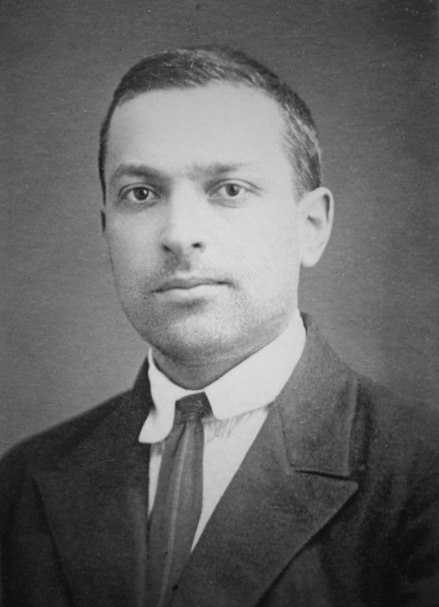
L. S. Vygotsky (1896-1934)
Thought and Language
Developmental process inherently social
  Changes in society produce changes in human nature
Cannot study animals and humans the same way
  Difference between humans and animals is the way that tools are used
  Language is a distinctively human tool
  Egocentric speech—does not disappear but becomes inner speech
    Inner speech comes to control our mental life

Slide 19
L. S. Vygotsky (1896-1934)
The Zone of Proximal Development
One of Vygotsky’s most enduring concepts
  Distance between actual level of development and level of potential development
  Actual development level determined by standardized testing
  Potential development level determined by more sensitive exploration

Slide 20
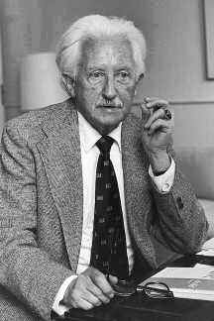
Erik H. Erikson (1902-1994)
Lifespan Developmental Psychology
Heavily influenced by Freudian theories
  Emphasized importance of early childhood experiences in shaping adult personality
Childhood and Society (1950)
  Stages of development that occur throughout the entire life cycle
  Shifted developmental psychology from child-focus to lifespan focus

Slide 21
Erik H. Erikson (1902-1994)
Epigenesis: Developmental stages unfold in a necessary sequence
  Progression through stages modulated by society in which a person develops
  Theory postulates a “cogwheeling of the life cycles”
  People are inherently social beings and caring for others is a key part of human evolution
  Stages do not proceed like links on a chain; they may overlap

Slide 22
Erik H. Erikson (1902-1994)
The Eight Stages
Basic trust vs mistrust
Autonomy vs shame and doubt
Initiative vs guilt
Industry vs inferiority
Identity vs identity diffusion
Intimacy vs isolation
Generativity vs stagnation
Integrity vs despair

