Slide 1
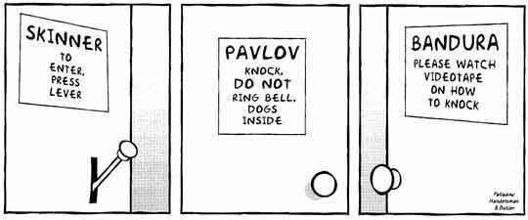
Psychology 4910
Chapter 12
Theories of
Learning

Slide 2
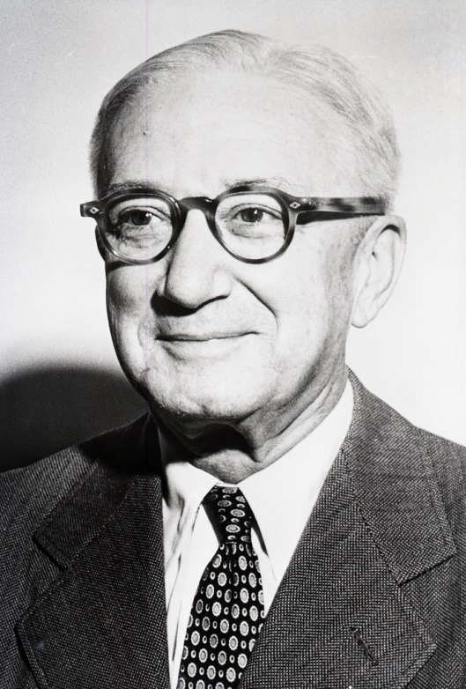
E. R. Guthrie (1886-1959)
Concluded that “the laws of logic are conventions and not laws of thought”
Skeptical of the possibility of a completely rigorous deduction and of ultimate validity in an argument
Presented his theory of learning informally

Slide 3
Contiguity
Contiguity: “A combination of stimuli which has accompanied a movement will on its recurrence tend to be followed by that movement”
Principle at the core of Guthrie’s learning theory
Many stimulus patterns have the potential to produce movement, but only some are effective
Called cues or signals

Slide 4
Repetition
Typical view: Repetition acts to strengthen the connection between stimulus and response
Guthrie’s view: Repetition provides opportunity for additional stimuli to become associated with a response
Once a habit is associated with a large number of stimuli, it becomes harder to change

Slide 5
Reward
Typical view: Reinforcement strengthens the connection between stimulus and response
Guthrie’s view: Reward acts to prevent the animal from unlearning the association formed just before the reward
Reward terminates the signal

Slide 6
One-Trial Learning
Guthrie’s approach was in touch with everyday life
Suggestions for meeting the problems of animal training, child rearing, and pedagogy
Example: Breaking a habit
Find the cues that initiate the action
Practice another response to these cues

Slide 7
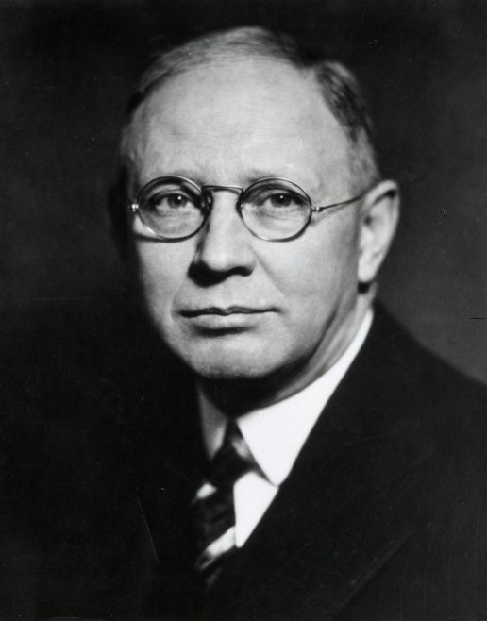
Clark L. Hull (1884-1952)
Proponent of principles of conditioning; opponent of Gestalt method
Motivational theory based on concept of drive
Any persistent and intense stimulus
Concept similar to basic psychoanalytic hypotheses about motivation

Slide 8
Hypothetic-Deductive Method
Hull attempted to create a mathematical theory from which all facts of learning could be deduced; theory consists of:
Postulates: Describe the basic laws of behaviour
Intervening variables: Hypothetical processes that occur inside the organism and are supposed to govern behaviour
Theorems: Experimentally testable hypotheses about behaviour

Slide 9
Postulates
Hull’s theory was elaboration of Thorndike’s law of effect
Primary reinforcer: Any stimulus that results in a reduction in drive
Secondary reinforcer: A stimulus that initially has no reinforcing properties but acquires them through association with a reinforcing stimulus

Slide 10
Postulates
Major Intervening Variables
Drive (D): Major motivational concept in Hull’s theory
Increases as a function of the amount of time that has elapsed since the last reinforcement
e.g., Drive decreases immediately after feeding an animal, then steadily increases until the next feeding

Slide 11
Postulates
Major Intervening Variables
Habits
Learned connections between stimuli and response
Formed as a result of reinforcement
Habit strength (_{S}H_{R}): Defined as a function of the number of reinforcements:
_{S}H_{R} = 1 − 11^{−aN}
Habit strength is equal to 1 minus 11 to the minus aN
N = Number of times a response to a stimulus has been reinforced
a = Constant value (~.03)

Slide 12
Postulates
Major Intervening Variables, cont’d
Stimulus-intensity dynamism (V): Amount of energy possessed by a stimulus that impinges on the organism
Incentive motivation (K): Amount of reward that follows a response
Reaction potential (_{S}E_{R}): Amount of energy available for a response:

Slide 13
Postulates
The end formula is…
_{S}E_{R} = _{S}H_{R} × D × V × K − _{S}I_{R} − I_{R}

Slide 14
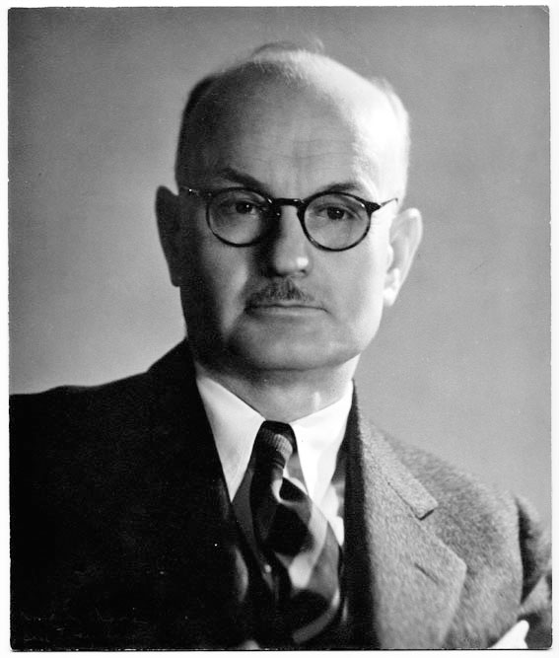
E. C. Tolman (1886-1959)
1914: Converted to behaviourism
= Phenomenology in operational behaviouristic terms
Blend of methodological behaviourism and Gestalt psychology with other influences
Methods diverged significantly from the way logical positivists argue that research should be done

Slide 15
Purposive Behaviour
Tolman attempted to explain molar (therefore, purposive) behaviour
Subject matter: Behaviour described with reference to the goal that animal is seeking
Molar descriptions: In terms of what behaviour is intended to accomplish
Molecular descriptions: In terms of specific muscular and glandular reactions

Slide 16
Cognitive Maps
Explanation of purposive behaviour requires understanding of how an animal represents its environment
Cognitive maps
Expectancies: Representations of what animal is likely to find by following different routes represented in the map
Expectancies integrated into sign Gestalts
Representations of the way one event leads to other events in the cognitive map

Slide 17
The Place versus Response Controversy
Does learning consist of the formation of stimulus-response connections?
If so, animals would learn specific responses to specific stimuli
Does learning consist of the formation of expectations?
If so, animals would learn a cognitive map that contains representations of themselves in relation to various aspects of their environment

Slide 18
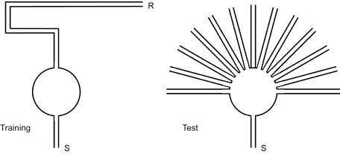
The Place versus Response Controversy

Slide 19
The Verbal Learning Tradition
Studies of verbal learning
Ebbinghaus’s nonsense syllables
Calkins’s paired associates and the memory drum

Slide 20
Acquisition
Irvin Rock (1922–95)
Tested hypothesis of one-trial learning
Called into question the notion of “practice makes perfect”
Results: Repetition plays no role in the formation of associations
Criticisms regarding experimental procedures used

Slide 21
Serial Learning
When asked to learn lists of nonsense syllables, participants learn the middle of the list more slowly than the ends
Serial position curves
“Real world” context?
Roediger and Crowder (1982)
Listing names of the presidents of the United States shows serial position curve

Slide 22
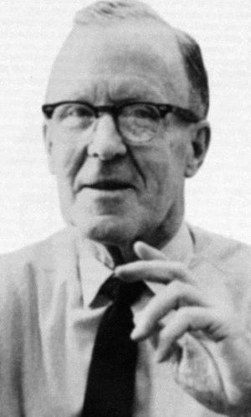
D. O. Hebb (1904-1985)
The Organization of Behaviour
Neuropsychology: Combined psychology (learning theory) with neurophysiology
Cell assemblies: Physiological mediating processes responsible for representing stimulation
Hebb rule: When neuron A fires neuron B, some change occurs in A or B or both which increases A’s capacity to fire B in the future
Phase sequences
Phantom limbs

Slide 23
Motivation
Hebb emphasized importance of arousal system:
“the nonspecific or diffuse projection system of the brain stem which was shown . . . to be an arousal system whose activity in effect makes organized cortical activity possible”
Arousal operates in a manner analogous to drive
Performance is optimal when arousal is moderate

Slide 24
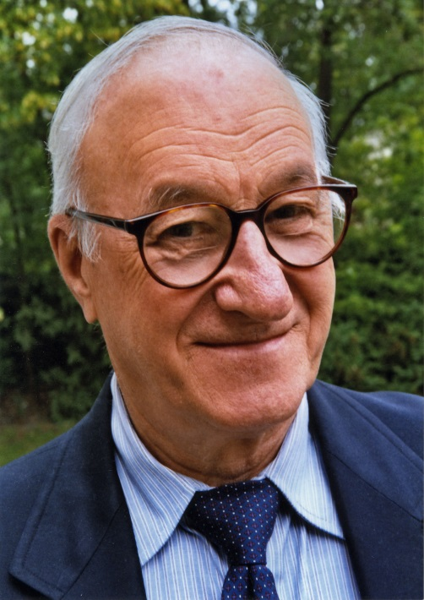
Albert Bandura (1925-
Interested in conceptualizing clinical phenomena so that they could be experimentally tested
Believed clinical practitioners were responsible for efficacy of their procedures

Slide 25
Social-Learning Theory
Stressed importance of modelling in shaping a person’s learned behaviour
Modelling takes place through observational learning
A person can acquire novel responses through observation of another person’s actions
Drawn out the social implications of modelling

Slide 26
Behaviour Modification
Mary Cover Jones (1896–1987)
Worked with a boy named Peter, who was afraid of furry objects
Placed a caged rabbit nearby while the boy was fed
Decreased distance between rabbit and boy on subsequent occasions
= Systematic desensitization

