Slide 1
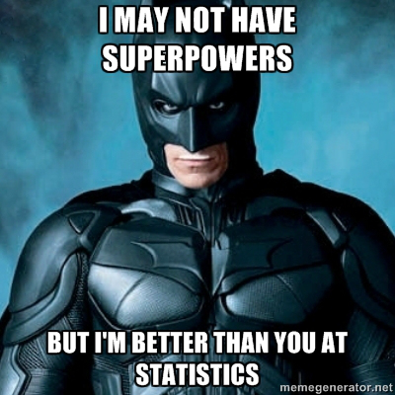
Psychology 4910
Chapter 11
Research Methods

Slide 2
Introduction
Nineteenth century
Introspection
Behavioural observation
Early twentieth century
Logical positivism
Statistical methods
Methods for experimental vs. non-experimental data

Slide 3
Logical Positivism
1920s: Group of physicists, logicians, and mathematicians called the Vienna Circle
Tried to formulate general principles for gathering knowledge
Drew upon disciplines like physics and chemistry

Slide 4
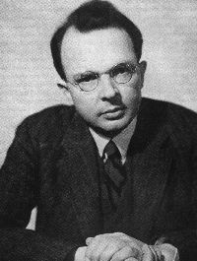
Logical Positivism
Rudolf Carnap
Knowledge is embodied in language
Science lies at the bottom of a set of statements referring to observations
Truth or falsehood of statement must be objectively verified
How to verify these statements?
Verification principle: Meaning of a statement is its method of verification

Slide 5
Logical Positivism
Carnap: Protocol sentences
Refer to publicly observable events
Should be used when we do experiments
Meaningful statements can be translated into protocol sentences

Slide 6
Dispositional Concepts
Dispositional concepts: Descriptions of lawful relationships between IVs and DVs
If X then Y, where X is a stimulus and Y is a behaviour
Principle of falsifiability became crucial criterion for separating scientific approaches from non-scientific ones
Heavily influenced by philosopher Karl Popper

Slide 7
Operationism
Operationism: View that all psychological concepts ultimately refer to publicly observable occurrences
Attributed to physicist Percy Bridgman
Operational definitions: Specify how a concept is measured
Ensure that psychological concepts refer to publicly observable events

Slide 8
Where Did Psychologists Stand?
Behaviourists & neo-behaviourists
Welcomed logical positivism and operationism
Gestalt psychologists
Damaged by the new philosophy of science
Psychoanalysts
Received much criticism from adherents of logical positivism/operationism

Slide 9
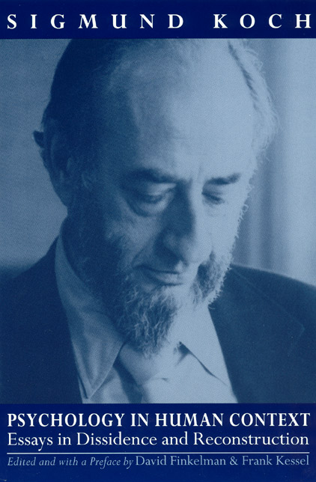
Criticisms of Operationism
Sigmund Koch (1917–96):
Some psychologists went overboard with operational definitions
Operationism is not a way of creating psychological concepts
Context of discovery vs. context of justification

Slide 10
Experimental Methods
Statistical Inference
Early experiments:
Detailed descriptions of individual cases
No explicit rules for making generalizations
Relied heavily on subjective interpretation
Some did use graphs to represent their data
e.g., Ebbinghaus, Thorndike

Slide 11
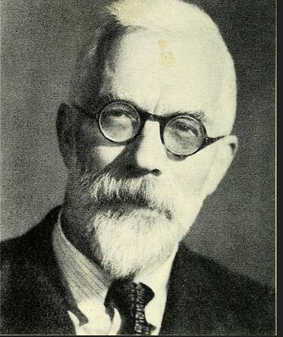
R.A. Fisher (1890–1962)
Fisher’s Approach to Designing Experiments
Random order: Determined by a purely chance procedure
Possible to determine how likely participant is to make correct choice by chance alone
How much chance is acceptable?
Fisher suggested criterion of one chance in 20 (5%)

Slide 12
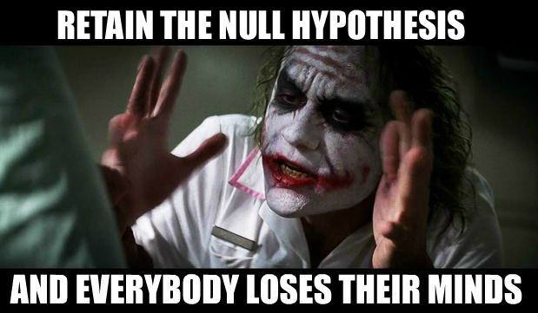
R.A. Fisher (1890–1962)
The Null Hypothesis
Assumption in an experiment that any differences between experimental conditions are due only to chance
“Null” = “no difference”
Can never prove the null hypothesis; only possible to disprove it
Controversial concept
Falsifying the null hypothesis does not verify an alternative hypothesis

Slide 13
R.A. Fisher (1890–1962)
The Null Hypothesis, cont’d
Fisher: 5% level of significance was arbitrary
Still, many psychologists adopted it as article of faith
End of 1950s:
Goal of psychological research = Achievement of “statistical significance” (p = 0.5)
Fisher: Statistical significance is no substitute for repeatability
Lack of replication continues to be an issue in psychology

Slide 14
Correlational Methods
Utilize the same underlying principles as experimental designs
Typical correlational experiment:
Obtain different measures on a set of participants
Examine strength and direction of relationships between variables

Slide 15
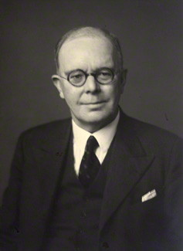
Charles Spearman (1863-1945)
Worked with Cyril Burt
Laid groundwork for factor analysis
Begins with a set of correlations between a number of measures
Statistical procedures for deriving a number of underlying factors to describe the structure of the set of correlation coefficients

Slide 16
Charles Spearman (1863-1945)
Two-factor theory of intelligence
Derived from Spearman’s factor analysis of different tests of mental abilities
Every individual measurement of every ability divided in two parts:
General intelligence factor, g
Represents amount of mental energy available to an individual
Specific factor, s
Represents abilities needed to succeed in certain subjects
g
French
English
Math
Music

Slide 17
Charles Spearman (1863-1945)
Specific abilities tend to be strongly (but not perfectly) correlated
Those who perform well in one subject tend to perform well in others
Each specific ability determined by g, and by circumstances specific to that skill
g shaped by genetics, but s could be shaped by education

Slide 18
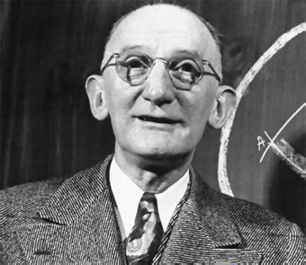
Louis Leon Thurston (1887-1955)
Developed factor-analytic techniques in the United States
Wanted to uncover a set of mental abilities that were independent of each other
De-emphasized importance of g
More important to examine person’s profile of abilities than to summarize intelligence with a single number

Slide 19
Louis Leon Thurston (1887-1955)
Primary mental abilities
Verbal (e.g., learning vocabulary)
Number (e.g., doing arithmetic)
Spatial (e.g., identifying a design)
Word fluency (e.g., thinking of words of a particular type)
Memory (e.g., remembering a series of digits)
Reasoning (e.g., following a rule)

Slide 20
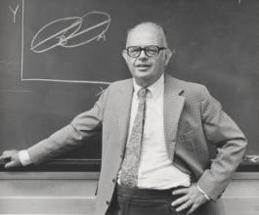
Lee J. Cronbach (1916-2001)
APA Presidential Address
Reviewed development of research methods in psychology
Saw psychology as two distinct methodological approaches:
Experimental psychology
Correlational psychology

Slide 21
Lee J. Cronbach (1916-2001)
Used model to represent methodological distinctions existing in psychology around mid 20th-cen.
Data gathered by Thorndike
Laboratory data vs. field data
Laboratory experiments vs. differential studies
Quantitative vs. verbal
Psychologists who rely on numbers vs. those whose medium is language

Slide 22
Lee J. Cronbach (1916-2001)
Methodological differences had resulted in groups consisting of:
“personality, social, and child psychologists”
“perception and learning psychologists”
Experimenters concerned with effects of particular treatment on behaviour
May feel lack of control over all relevant variables

Slide 23
Lee J. Cronbach (1916-2001)
Correlational psychologists concerned with the fact that all participants do not respond in the same way to the same treatment
Applied psychology → improves decisions about people

Slide 24
Qualitative Research Methods
Quantitative research methods: Aggregate objects, events, or persons under study to make general statements about people as a whole
Rely more heavily on statistics
Qualitative research methods: Designed to develop description of the way individuals represent the world they live in
Rely more heavily on language, storytelling

Slide 25
Qualitative Research Methods
Gained favour at end of twentieth century
Approach involves:
Discovery-oriented analysis of verbal text
Small sample sizes
Discursive psychology: Studies how people ordinarily report, explain, and characterize actions and events

