Slide 1
Psychology 4910
Chapter 10
Gestalt Psychology and
the Social Field

Slide 2
Introduction
Concept of Gestalt introduced by Goethe
Gestalt psychologists: There are many important phenomena whose characteristic properties cannot be reduced to the sum of their parts
Our perception cannot be reduced to sensations
Our behaviour cannot be reduced to muscle movements

Slide 3
Introduction
Saw introspection and behaviourism as missing the “thing that matters”
Thought the bottom-up approach to understanding phenomena is doomed to fail
Appreciate any psychological phenomena as an integrated whole
Science is about trying to understand and appreciate order in nature

Slide 4
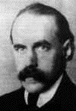
Max Wertheimer (1880-1943)
Considered to be the founder of Gestalt psychology
University of Frankfurt
phi phenomenon

Slide 5
Phi Phenomenon
Demonstration:
Two lights, turned on alternately by a switch
Each light casts a different shadow on the screen
At right rate of alternation, participant sees one shadow moving back and forth (rather than two)
Showed that:
Apparent motion is not a result of inference
Our perception is not just a copy of the stimulus

Slide 6
The Minimum Principle
We do not perceive what is actually in the external world
We organize our experience so that it is as simple as possible
Simplicity guides our perception; may even override previous experience
e.g., phi phenomenon

Slide 7
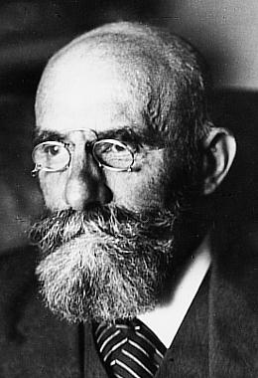
Precursors of Gestalt Psychology
Christian von Ehrenfels (1859–1932)
Experiences should be understood as composed of individual sensations + a Gestalt quality that provided the form of the experience
Immanuel Kant
Our experience is a construction; we impose cause-and-effect relationships on the world

Slide 8
Precursors of Gestalt Psychology
Phenomenology
Describe consciousness as it presents itself, without trying to decipher its function

Slide 9
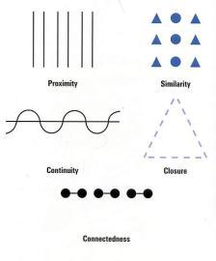
The Laws of Perceptual Organization
Intended to describe the basic ways in which we organize our experience as simply as possible

Slide 10
Productive Thinking
Improper teaching methods lead to:
Rote memorization
Poor transfer between situations
Good teaching methods lead to:
Deeper understanding of problem structure
Ability to grasp the Gestalt of the problem
“Structurally blind” teaching methods teach principles that generalize

Slide 11
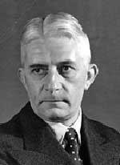
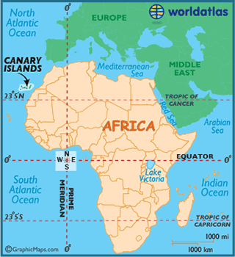
Wolfgang Köhler (1887-1967)
Marooned on Tenerife, in the Canary Islands, during WWI
Studied chimpanzees on the island
Resigned from Psychological Institute at University of Berlin after Nazi rise to power
Gave caricature of Nazi salute in a 1933 lecture (salute was required by law)
Explained that he did not agree with Nazi ideology

Slide 12
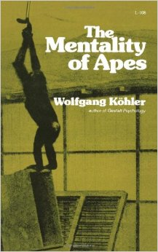
Wolfgang Köhler (1887-1967)
Wrote “Mentality of Apes”.
Concerned with testing “the intelligence of the higher apes . . . whether they do not behave with intelligence and insight under conditions which require such behavior”
Insight: Ability to understand how different parts of a situation are related to one another
Insightful problem-solving was all-or-none phenomenon; the animal saw the solution or it did not

Slide 13
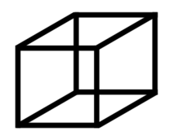
The Concept of Isomorphism
Isomorphism: Novel approach to relation between experience and the brain
Variant of psychophysical parallelism
Correspondence between events in the brain and events in the mind is structural
Changes in structure of brain processes should result in corresponding changes in structure of experience
e.g., studies using a Necker cube

Slide 14
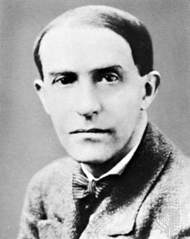
Kurt Koffka (1886-1941)
Studied for one year at University of Edinburgh
Made connections with English-speaking people
Laid foundation for international recognition
Completed studies at University of Berlin
Wrote the “Bible” of Gestalt psychology

Slide 15
Kurt Koffka (1886-1941)
Wrote “Principles of Gestalt Psychology.”
Geographic environment: Environment as it “actually is”
Behavioural environment: Environment that actually determines our behaviour
Contains a person’s phenomenal world of lived experience
It’s only when geographic environment enters behavioural environment that one is affected

Slide 16
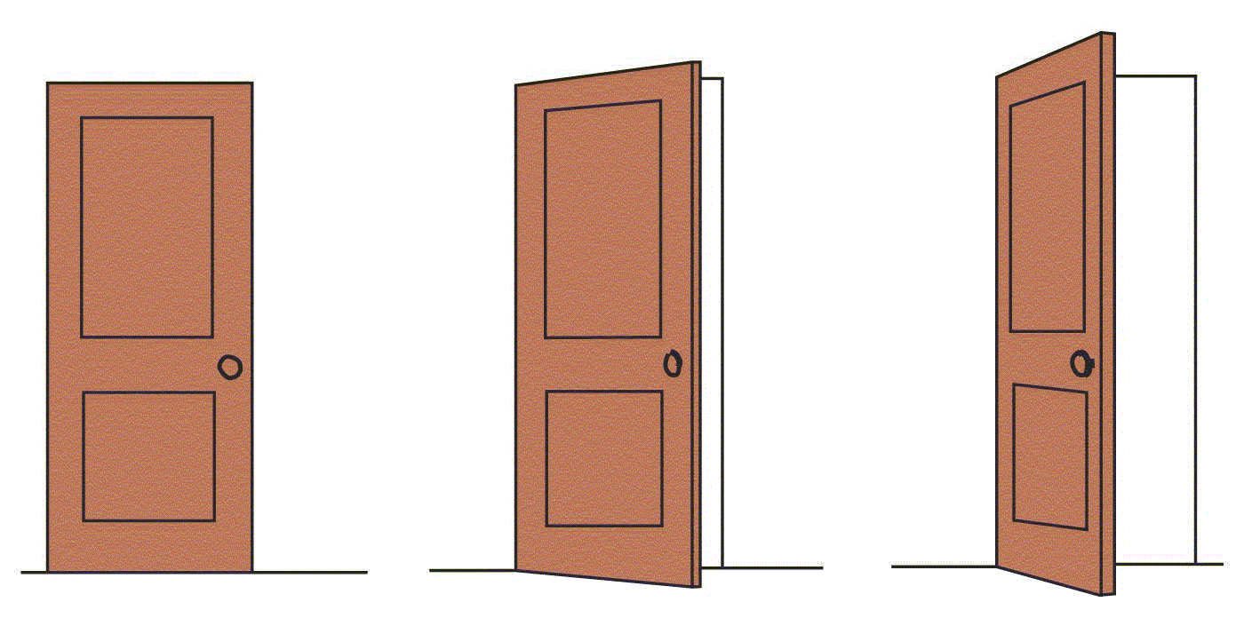
Why Do Things Look as They Do?
Distal stimuli: Things as they exist in geographic environment
Proximal stimuli: Effects that distal stimuli have on the surface of a receptor organ
Perceptual constancies: Our perception of properties of objects remains the same, even though proximal stimulus may change

Slide 17
The Growth of the Mind
Gestalt psychologists incorrectly accused of being “nativists”
Gestalt laws appear innately determined rather than learned
Gestalt psychologists view Gestalt laws of organization as necessary consequence of physical laws
Minimum principle is a physical law, not innate or learned

Slide 18
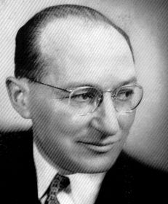
Kurt Lewin (1890-1947)
1910: University of Berlin
PhD: Psychological Institute
Influenced by Gestalt psychologists
Influenced by Ernst Cassirer
Believed that people represent their experience by means of symbolic forms
1933–35: Worked at Cornell University
1935–44: Worked at University of Iowa
1944: Director of Research Center for Group Dynamics at MIT

Slide 19
Kurt Lewin (1890-1947)
Wanted to create practical psychology which balanced individual and social influences
Field: All the forces acting on an individual at a particular time
Life space: Psychological field we are interested in B = f (P, E)
B = behaviour of an individual at a certain moment
P = person
E = environment

Slide 20
Group Dynamics
Action research: Program of research designed to gather data and lead to social change
Lewin’s studies in group dynamics
Change in group dynamics will change the way an individual perceives and acts
e.g., sensitivity training experiments (T-groups)
Opportunity to “see yourself as others see you”
Aimed to combat racial and religious prejudice

Slide 21
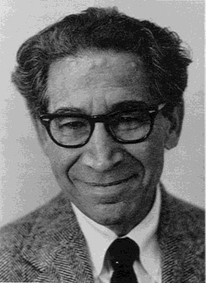
Leon Festinger (1919-1989)
Looked at cognitive dissonance.
Experiment:
Participants spent one hour doing boring tasks
Asked to tell the next participant (a confederate) that the tasks had been really interesting
One group offered $1 for lying; another, $20
Those who received $1 rated the experiment more interesting than those who received $20
Explained by dissonance reduction

Slide 22
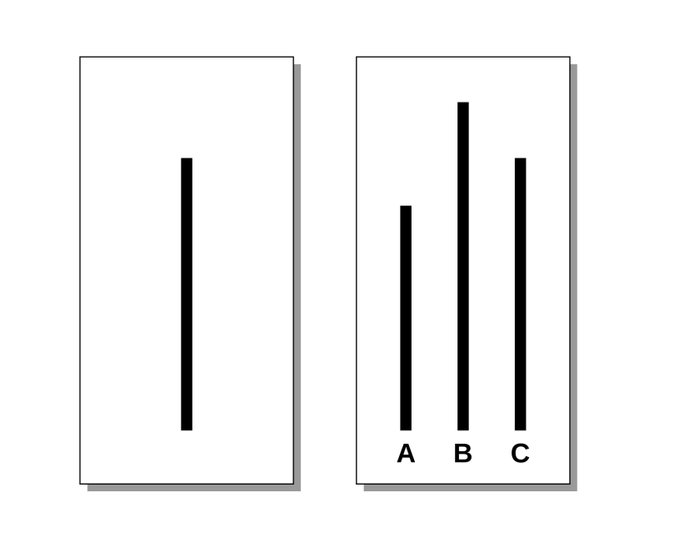
Solomon Asch (1907-1996)
Did work on conformity.
Experiment
Groups of 7–9 men (all but 1 were confederates)
Groups presented with a series of line judgment tasks
Confederates made incorrect judgments
Results: Participants conformed to confederates in 37% of trials

Slide 23
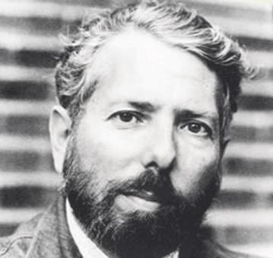
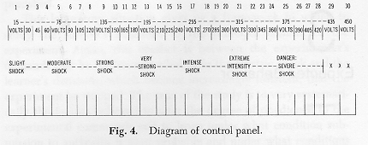
Stanley Milgram (1933-1984)
Worked on studies of obedience while at Yale.
Participants to give a test to another person (confederate)
Participants to deliver electric shock to this person whenever they produced a wrong response
Increasingly strong shocks with each wrong answer
Results: 26 of 40 participants delivered shocks until the end of the scale

Slide 24
Stanley Milgram (1933-1984)
Profound impact on field of psychology
Could not be conducted under modern ethical guidelines
Current studies on obedience may be lacking in realism and validity

