Slide 1
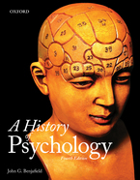
Psychology 4910
Chapter 1
Psychology and History

Slide 2
Studying the History of Psychology
There are two approaches to history:
Person: emphasizing the role of the creative person that moved history along.
Zeitgeist: the spirit of the times.
You must understand the cultural context in which one’s work takes place.

Slide 3
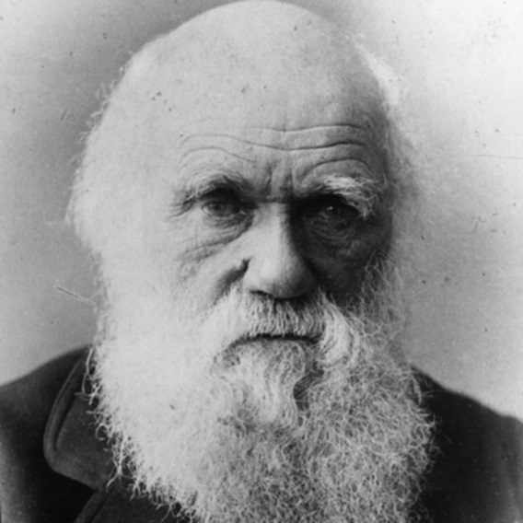
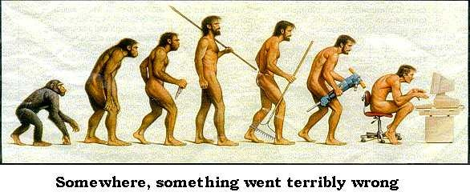
Studying the History of Psychology
Eg. Was the theory of evolution the result of Darwin’s genius, or would it have been produced by someone else anyway.

Slide 4
Studying the History of Psychology
Ixion’s Wheel v. Jacob’s Ladder
Is history progressive or cyclical?
Progressive: Moves continuously forward to a fixed or indefinite end, getting better and better along the way.
Cyclical: Circular in nature, eternal recurrence.
Ideas may go out of fashion and then re-emerge down the road.

Slide 5
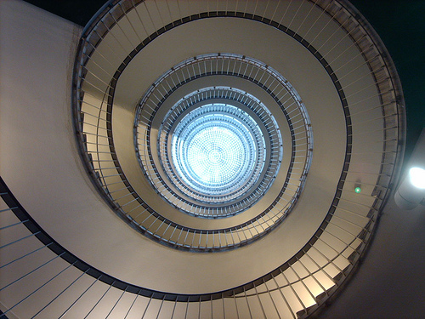
Studying the History of Psychology
The history of psychology is probably both.
Like a spiral, moving upward and in circles at the same time.
Ideas are constantly being re-discovered but in more sophisticated way.

Slide 6
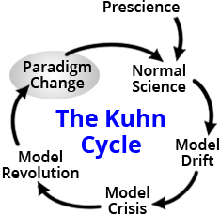
The New History of Psychology and Science
Psychology is a science, but science has a subjective component.
Science does not develop continuously and smoothly.
Thomas Kuhn suggests that there are paradigm shifts.

Slide 7
The New History of Psychology and Science
Paradigm: A set of fundamental beliefs that guide scientists and shapes their view of the world.
In a paradigm shift, an old paradigm is overthrown and a new way of thinking emerges.
Eg. Evolution

Slide 8
Feminism and the Psychology of Feminism
Feminism has changed the history of psychology by identifying distortions and biases in psychology.
Previously, the contribution of women to psychology had not been acknowledged.
Women who had received their PhD in psychology between 1906 and 1945 were making 40% of what men were making.

Slide 9
Feminism and the Psychology of Feminism
Women often took inferior positions due to family responsibilities

Slide 10
Feminism and the Psychology of Feminism
Kimball: Two traditions of feminist scholarship
Emphasized overwhelming similarities between genders
e.g., Leta Hollingworth
Emphasized undervalued characteristics (e.g., caregiving) traditionally associated with women
e.g., Evelyn Fox Keller

Slide 11
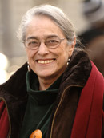
Feminism and the Psychology of Feminism
Evelyn Fox Keller
Struck by:
The relative absence of women in the sciences
The fact that the style of thinking practised by scientists had a masculine origin
Argues that:
Gender and science are social constructions
We need to be aware of the science-gender system
Consider how science is also personal and social in nature
Does not mean ignoring successes of “masculine” in science

Slide 12
Psychology as a Social Construction
Psychology is not the objective accumulation of knowledge.
It is driven by social processes.
There are both exogenic and endogenic processes involved.
Exogenic: Coming from the outside. External factors shape the human experience.

Slide 13
Psychology as a Social Construction
Endogenic: Coming from inside. Humans have tendencies to think, categorize, and process information. These tendencies shape our knowledge.

Slide 14
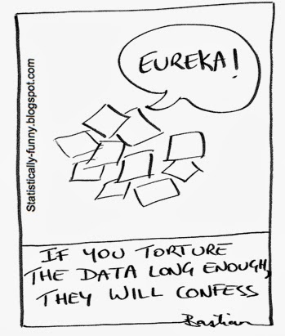
Psychological Research as a Social Construction
Implies that research is not objective.
In a sense, this is true.
Experiments chosen depend on
Ethics
Economics
Policy interests, etc.

Slide 15
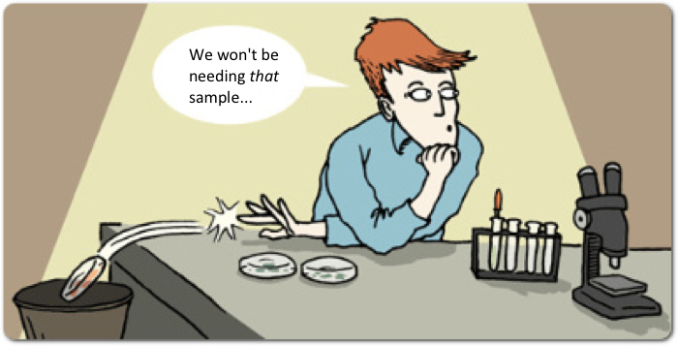
Psychological Research as a Social Construction
A manuscript is full of rhetorical deftness and artful editing.
Putting best foot forward
Data analysis often depends on viewpoint.
Eg. trends
Whether or not a study is reported depends on viewpoint.

Slide 16
Psychological Research as a Social Construction
But research can be a social construction and still be true in an objective sense.
Eg. double helical nature of DNA
Research can still have empirical content.
Research is not done in a vacuum, it is not private.
Psychology consists of social objects constructed through the interaction of real historical individuals.

Slide 17
Reconciling the “Old” and “New” Histories
The new history points to omissions in the history of psychology.
The older history engaged in presentism.
Evaluate the past in terms of relevance for the present
They failed the understand earlier works in its own terms.

Slide 18
Reconciling the “Old” and “New” Histories
This is opposed to historicism.
The understanding of the past for its own sake; valuing the past more than the present.
There must be a balanced approach.
Rediscover what the psychologist was trying to accomplish.
Do not assume they were trying to lay the groundwork for what we have now.

Slide 19
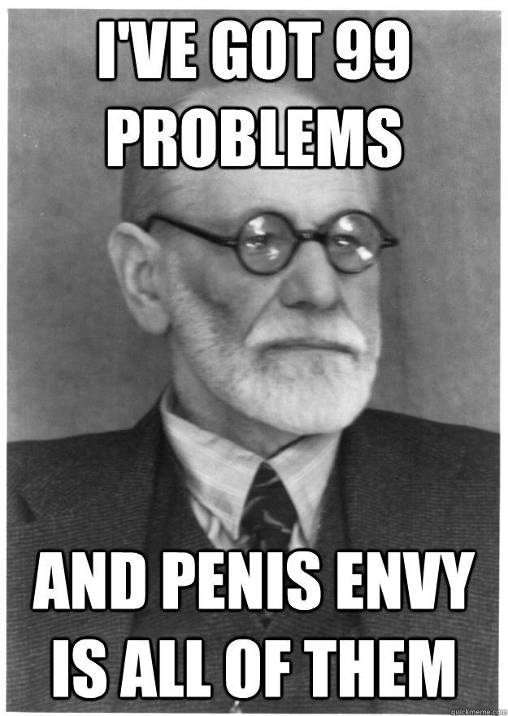
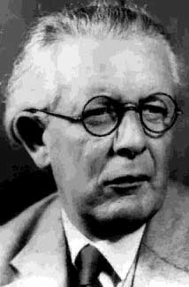
Reconciling the “Old” and “New” Histories
We cannot be too critical previous thinkers.
Eg. Sigmund Freud, Jean Piaget

