Slide 1
Ingestive Behaviour
Chapter 12
PSYC 3801
11 March, 2014
Notes:
Jesse Whiteman, Course TA (office in SN 1052, office hours Wed 12-2, email is jwhiteman88@gmail.com). Feel free to contact me or drop by with any questions about the material!

Slide 2
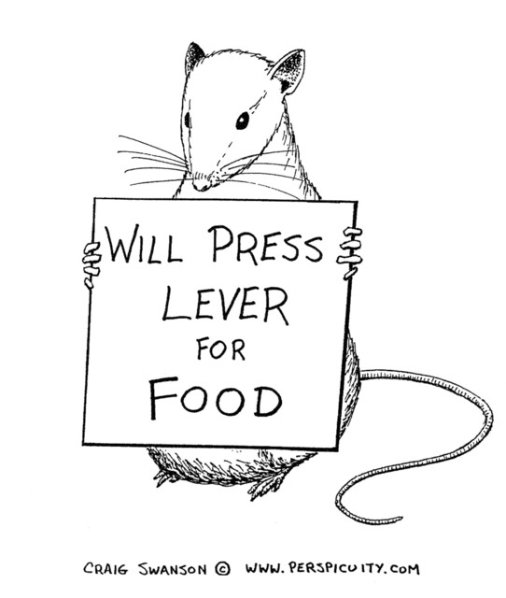

Slide 3
Lecture Overview
Facts about Metabolism: CAF
What starts a meal?
What stops a meal?
Positive-Incentive Theory
Brain Mechanisms: The brain stem
The Hypothalamus & Hunger
The Hypothalamus & Satiety
Eating Disorders: Causes & Treatment
An applied example of neuroscience research on eating: 5-HT, carbs, & satiety

Slide 4
Metabolism
  When we eat (and digest) we incorporate molecules that were once part of other plants and animals into our bodies.
  These molecules are ingested to provide molecular building blocks and fuel.
Cells need fuel and O₂ to stay alive; fuel comes from digestive tract (and is there because of eating).

Slide 5
Energy storage & metabolism
All the energy we need to move, think, breathe and keep constant body temp is derived in the same way:
  It is released when the chemical bonds of complex molecules are broken, and smaller, simpler compounds are made.
Energy gets to the body in 3 forms: lipids (fats), amino acids (breakdown products of proteins), and glucose (breakdown product of complex carbs- starches and sugars).
Energy is stored in the body as fats [triglycerides](85%), protein in muscle (14.5%), and glycogen in liver and muscle (0.5%).

Slide 6
Three phases of energy metabolism
Cephalic Phase- Preparatory, begins with sensory (head)cues: sight, smell, or thought of food. Ends with beginning of absorption into bloodstream.
Absorptive Phase- Energy absorbed into bloodstream from a meal is meeting the body’s energy needs.
Fasting Phase- Unstored energy from previous meal used, energy is withdrawn from reserves to meet immediate requirements.
Notes:
C starts with cues. A food is in Dtract, F. food isn’t in tract. F phase ends when next C phase starts
(Cephalic means head).

Slide 7
Metabolism
The flow of energy throughout the stages of metabolism is controlled by two pancreatic hormones: Insulin & Glucagon.
During C & A phases:⬆ insulin, ⬇glucagon levels in blood.
During F phase: ⬆ glucagon, ⬇ insulin.
Notes:
Fig 12.12!

Slide 8
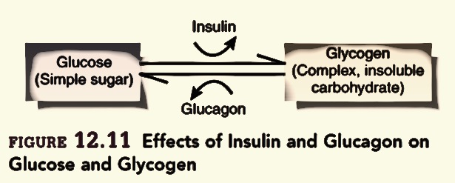
Effects of Insulin and Glucagon

Slide 9
Insulin
Insulin does 3 things:
  Promotes the use of glucose as 1º energy source.
  Promotes conversion of fuels to storable forms; glucose to glycogen and fat, amino acids to proteins.
  Promotes storage of glycogen in liver and muscle, fat in adipose tissue, and protein in muscles.

Slide 10
C&A Phases: Insulin
During C phase, Insulin’s function is to lower the amount of fuels (e.g., glucose) in the bloodstream in anticipation of fuel influx from the coming meal.
During A Phase, Insulin’s function is to minimize the increasing amount of these fuels by using and storing them.

Slide 11
The A phase: nutrient fates
As nutrients are absorbed, BGL rises. Rise is detected by the brain.
  = ⬇sympathetic and ⬆ parasympathetic activity.
This change tells the pancreas to stop glucagon release, start insulin release.
Insulin lets body cells use glucose as fuel. Extra glucose converted to glycogen, which fills short-term reservoir.
Some AAs are used to build proteins and peptides, rest are converted to fats, stored in adipose tissue (long-term reservoir)
Notes:
Glucose can only be taken up by cells outside the brain by using a glucose transporter, which requires insulin to work.

Slide 12
The F Phase: ⬆ Glucagon
A fall in BGL causes the pancreas to stop releasing insulin and to release glucagon.
High glucagon levels promote:
  conversion of fats to free fatty acids, use of FFAs as energy source.
  Conversion of glycogen to glucose, FFAs to ketones, and protein to glucose.
Without high levels of insulin, glucose can’t enter most cells (this saves the glucose for the brain).
  Body cells live off fatty acids (glucagon tells fat cells to break down triglycerides into fatty acids and glycerol. Body cells live off FAs, brain gets glycerol).
Notes:
Fats are triglycerides, broken down by glucagon into glycerol and fatty acids. The body uses fatty acids, while glycerol is is turned into glucose by the liver, and this glucose is used by the brain.

Slide 13
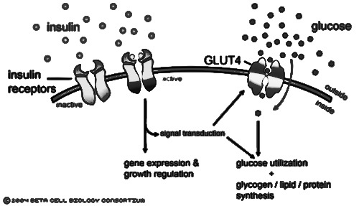
Glucose needs insulin binding to enter cells
Notes:
GLUT4 is an insulin transporter found in many tissues, including brain regions like the hippocampus

Slide 14
What starts a meal?
Hunger is the internal state of an animal seeking food.
The main purpose of hunger: increase the probability of eating.
main purpose of eating: supply the body with building blocks & energy needed to survive and function.
Keeping a stable body weight requires a balance between food intake and energy expenditure (kcal in, kcal out).
Notes:
Ingest more energy than expend, you gain body weight, and vice versa.

Slide 15
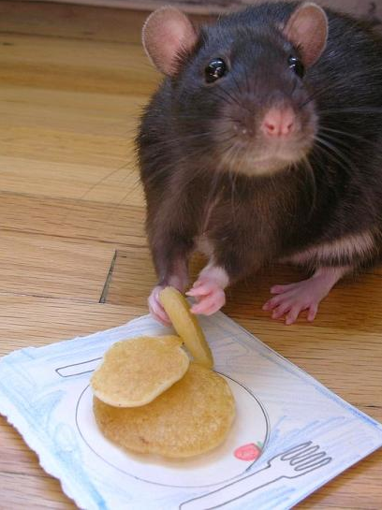
What starts a meal?
Environmental signals
– Sights, smells, and conditioned routines (C phase head factors) can start a meal.
Notes:
Evolutionarily, better to eat when food is plentiful and store for long term than to cut off eating when sated (see next slide)
This little fella’s name is Banjo, apparently.

Slide 16
Starting a meal: environmental signals
In the past, starvation was a much greater threat to survival than overeating.
Tendency to overeat in times of plenty = reserve to be drawn on in times of scarcity.
Selection for systems that detect losses from long-term reservoir, produce strong signal to seek and eat food.
Selection for mechanisms that detect weight gain and suppress overeating much less significant.
Notes:
Remember, long-term reservoir is fats in adipose tissue (short term is glycogen in liver and muscles)

Slide 17
What starts a meal? the bottom line
Most of the time, our motivation to eat will not be based on a physiological need for nourishment.
  Set point thinking is misguided
(an avalanche of evidence to come)
Notes:
*State of being motivated to eat (I’M HUNGRY) isn’t because body needs carbs, fats, etc. in some homeostatic way.
Carlson doesn’t make this point explicitly but it is important.

Slide 18
Hunger: Stomach Signals
The stomach hormone ghrelin is a powerful stimulator of food intake (fig. 12.13).
Ghrelin injections can stimulate vivid thoughts about favourite foods (Schmidt et al., 2005).
Injections of nutrients into the blood do not suppress ghrelin secretion, so the release of the hormone is controlled by the contents of the digestive system and not by the availability of nutrients in the blood (Schaller et al., 2003).
Ghrelin levels go up before a meal, down after (see next slide).
Notes:
GH (growth hormone) releasing factor.
Release has to do with what’s in your gut, not how much fat/protein/sugar is in your blood. Empty stomach leads to ghrelin release in Small intestine.

Slide 19
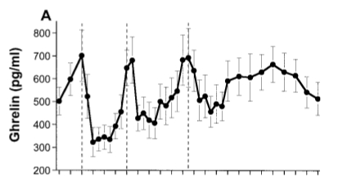
Ghrelin levels and meal times
Cummings et al., 2001
Notes:
8, 12, 5 for meal times (dashed vertical lines) on X axis. Levels of ghrelin go up before a meal and down right after.

Slide 20
Hunger: Metabolic signals
Inducing a dramatic fall in blood glucose level is a potent stimulator of hunger.
Similar effect for inducing big drop in fatty acids.
These are glucoprivation and lipoprivation experiments.
Notes:
This kind of fall in BGL (65%) doesn’t exactly happen often in the real world.

Slide 21
What stops a meal? Head factors
Most effects of sensory info from food (appearance, odour, taste, etc.) on food intake behaviours involve learning.
The act of eating does not induce long-lasting satiety.
  An animal with a gastric fistula will eat indefinitely.

Slide 22
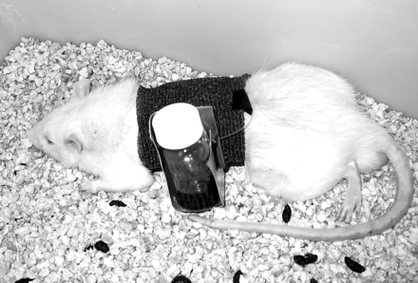
Gastric Fistula
Xu et al., 2003

Slide 23
What stops a meal? Head factors
Taste and odour are important stimuli that let animals learn about caloric content of foods.
Cecil et al (1998): People were more satiated after eating a bowl of high-fat soup than when an equal amount of soup was infused directly into their stomachs.
  The act of tasting and swallowing contributes to the feeling of fullness caused by the presence of food in the stomach.

Slide 24
What stops a meal? GI factors
Cholecystokinin (CCK) released by small intestine controls rate of stomach emptying; provides satiety signal to the brain via vagus nerve.
  CCK injections suppress eating.
  Destroying sensory axons in vagus nerve blocks appetite-suppressing effect of CCK.
Another satiety signal is peptide YY₃₋₃₆ (PYY). It is released by the small intestine right after eating in levels proportional to the calories ingested.
Notes:
High levels of CCK can cause a CTA (conditioned taste aversion), but it suppresses eating below those levels, so is a satiety peptide.
We will get to how these signals act on/in the brain later.
CCK secreted in response to fats, detected by receptors in duodenum.
CCK doesn’t act on brain, receptors between stomach and SI.

Slide 25
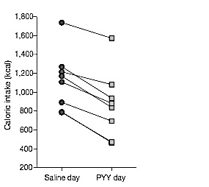
PYY in humans
Fig. 12.16 (From Batterham et al 2007)
Notes:
Each person in the study ate less calories on a day they were injected with PYY than on a day where they were just given saline. Jives with PYY going up when you’ve eaten (so it can help stop you eating)

Slide 26
What stops a meal? Adipose signals
A long-term satiety signal is leptin, a hormone released by adipose tissue.
Leptin causes ⬇ food intake and ⬆ metabolic rate.
Obese Ob-strain mice given leptin injections become more active, eat less, and have higher heart rates and body temperatures.
Notes:
Remember the body’s long-term energy reservoir is the fat (triglycerides) in adipose tissue.
Leptin comes from Greek word for thin, leptos. (in case you haven’t banished the stats word leptokurtic from your memory yet)
Ob-Ob mice fat cells don’t make leptin due to a mutation, and are very fat, eat a lot, have low metabolisms etc.

Slide 27
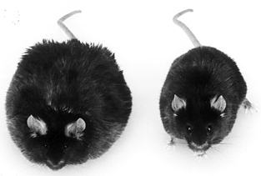
ob/ob Mice
Notes:
Left: 67g, Right (leptin treated): 35g. (normal weight for this age mice is 25g).

Slide 28
Leptin as a long-term regulator of body weight
When weight is gained, the increase in fat mass causes more leptin to be released.
  Suppresses feeding, ⬆ metabolism & activity = weight loss.
When weight is lost, fatty tissue is reduced in mass, and ⬇ leptin circulates in the body.
  This triggers increased food intake and reduced energy use, → compensatory weight gain.
Notes:
This effect of leptin means that as you gain weight, the rate of that gain will level off. Same with weight loss.

Slide 29
Do we have set points for energy and body weight?
Idea that:
  meal initiation and termination are a product of glucostatic set point
  long-term regulation is accounted for by lipostatic theory-each person has a set point for body fat.
Notes:
Main theories of hunger and body weight circa 1950’s.

Slide 30
Eating: the PITs
Set point theories can’t account for eating and hunger.
Positive Incentive Theory: Animals are drawn to eat not by energy deficits but by anticipated pleasure of eating.
Anticipated pleasure of a behaviour = its Positive-Incentive value.
Notes:
Most of the time you eat not because you have a deficit of energy or nutrients, but because you look forward to the pleasurable aspects of eating.

Slide 31
Determining when we eat: hunger before a meal
Eating meals stresses the body; before a meal the body’s energy stores are in homeostatic balance, and a meal disturbs this with an influx of fuels.
Body defends homeostasis; as mealtime approaches, C phase starts, releasing insulin into blood to ⬇ BGL.
Unpleasant feelings of hunger are not the body crying out for energy, but but sensations of it preparing for the expected disturbance in homeostasis.
Notes:
Stress, literally (since a broad definition of a stressor is anything that knocks you out of homeostatic balance).

Slide 32
Determining what we eat: Learning
Humans and other animals learn what to eat from others.
  Rats learn to prefer flavours experienced in mother’s milk, or smelt on breath of other rats.
  Culturally specific human food preferences.
Learned taste preferences and aversions
  Animals prefer tastes followed by an infusion of calories.
  Learn to avoid tastes followed by illness (CTA)
Notes:
Garcia and Seligman!
Chocolate and cinnamon for breath studies, adorably.
Even rats prefer chocolate chip cookies and M&Ms.

Slide 33
Determining When we eat: Pavlovian Conditioning of hunger
Hunger is caused by expectation of food, not deficit.
Rats given 6 meals/day at irregular intervals.
  Each meal signalled with buzzer-and-light conditional stimulus. Continued for 11 days.
  Food available throughout test phase.
Despite not being deprived, rats started to eat each time buzzer and light presented, even if they had recently finished a meal.
Weingarten, 1983, 1984, 1985.
Notes:
Pavlovian AKA classical conditioning: an unconditioned stimulus (food) produces an unconditioned response (eating). US (food) is paired with a conditional stimulus (CS- buzzer and light). The CS will then produce eating on its own, with eating now being the conditioned response, or CR. The point is that the CS-CR effect is so powerful it works even when the rat has recently eaten normally (and can’t possibly be deficient in nutrients). Think about how this might work with cues in your own life and daily routine!

Slide 34
Brain Mechanisms: the Brain Stem
Rats who have been decerebrated (transected so muscles for ingestive behaviour are only controlled by the hindbrain) can:
  distinguish between different tastes.
  respond to hunger and satiety signals (drink more sucrose if food deprived for 24 hrs., less if some has been injected into stomach).
    Suggests brainstem has circuits that can detect hunger and satiety signals, and control some aspects of food intake (fig. 12.20).

Slide 35
Brain Stem mechanisms
A part of the medulla including the area postrema and nucleus of the solitary tract (AP/NST) receives taste info from the tongue, sensory information from visceral organs.
Neurons in the AP/NST increase their activity in response to events that produce hunger.
AP/NST lesions eliminate hunger caused by both lipid and glucose deprivation.

Slide 36
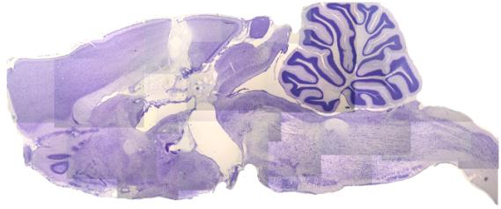
Decerebrated rat brain
Psychology Dept., University of Pennsylvania

Slide 37
The Hypothalamus and Hunger
The lateral hypothalamus contains two appetite-inducing hormones, or orexigens:
  Melanin-concentrating hormone (MCH)and orexin. These peptides stimulate hunger and decrease metabolic rate to increase and preserve the body’s energy stores.

Slide 38
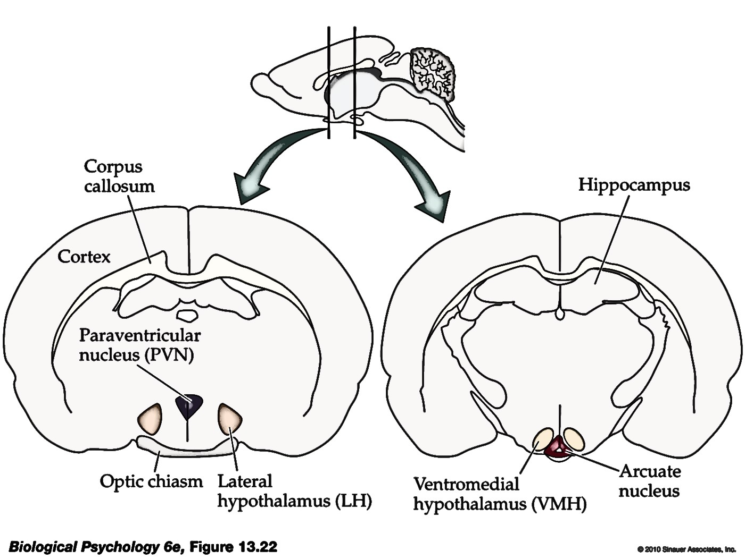
Rat hypothalamus
Rosenzweig, Breedlove, & Watson (2010)

Slide 39
The hypothalamus and hunger
Injecting orexin or MCH into the lateral hypothalamus stimulates eating.
Deprive rats of food, mRNA levels for these two peptides go up.
Mice with mutant MCH genes:
  produce too little MCH= eat ⬇, underweight.
  Produce too much MCH= eat ⬆, overweight.

Slide 40
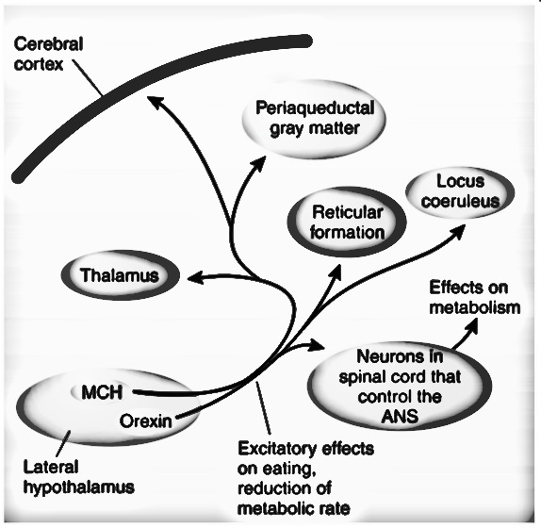
Feeding Circuits: projections of LH orexinergic neurons
Carlson, Fig 12.23

Slide 41
How are MCH and orexin neurons activated?
Neuropeptide Y (NPY): Found in the arcuate nucleus. NPY stimulates:
  Feeding
  Insulin & glucocorticoid release
  ⬇ triglyceride breakdown
  ⬇ body temperature

Slide 42
NPY & Hunger
Levels of NPY in hypothalamus ⬆ by food deprivation, ⬇ by eating.
NPY receptor antagonists suppress eating caused by food deprivation.
Glucoprivation and ghrelin activate orexigenic NPY neurons.
NPY neurons in the arcuate nucleus project to MCH/orexin neurons in lateral hypothalamus.

Slide 43
NPY and eating
Infusion of NPY =
  “ravenous, frantic” eating
  rats will work very hard for food
  eat bad tasting food
  eat despite pain (e.g., electric shock).
Notes:
Or: NPY = OM NOM NOM

Slide 44
NPY & AgRP
NPY neurons project to the PVN (which releases CRH).
Hypothalamic NPY neurons also release agouti-related peptide (AgRP).
NPY/AgRP neurons are inhibited by activation of their leptin receptors.
NPY/AgRP neurons activate MCH/orexin neurons; so leptin binding to NPY/AgRP neurons = ⬇ release of MCH & orexin.
Notes:
Leptin is a satiety factor, so makes sense it inhibits appetite inducing NPY/AgRP neurons.
Likewise, makes sense those NPY/AgRP neurons active orexigenic neurons.
Infusion of a tiny dose of AgRP into 3rd ventricle causes increase in eating that lasts for 6 days.

Slide 45
Endocannabinoids as orexigens
THC increases appetite (e.g., the munchies).
Endocannabinoids stimulate eating by ⬆ release of MCH and orexin.
endocannabinoid levels highest during fasting, lowest during feeding.
CB₁ receptor knockout mice are lean, resistant to obesity.
Notes:
Hey, it’s a technical term…

Slide 46
Suppressing appetite
Another anorexigenic signal in the arcuate nucleus is CART (cocaine and amphetamine-regulated transcript).
CART levels ⬆ during food deprivation.
Injection of CART into ventricles = ⬇ eating.
CART inhibits MCH and orexin neurons, increases metabolic rate through connections with PVN (⬆ CRH).
Notes:
Stress response gets energy mobilized, through adrenaline and noradrenaline, HPA axis including CRH release glucocorticoids like cort partly to help liberate even more energy as it used by actions stimulated by A and NA.
Anorexigenic= appetite suppressing

Slide 47
α-MSH
α-Melanocyte-Stimulating Hormone (MSH) is also released by CART neurons.
Produced from proopiomelanocortin (POMC), so releasing neurons are called POMC/CART neurons.
α-MSH is a melanocortin-4 receptor agonist; binds to MC-4R and inhibits feeding by inhibiting orexigenic neurons.
Notes:
MC-4R knockout mice get obese!

Slide 48
α-MSH & AgRP
AgRP is antagonist of MC-4R; binding stimulates feeding.
  blocks inhibition of orexigenic neurons.
Leptin stimulates release of CART,α-MSH; inhibits release of NPY, AGRP.
Notes:
Alpha-MSH binding to MC-4R on MCH/Orexin neurons inhibits these appetite-inducing cells. AgRP blocks MC-4R thus preventing this inhibtion of appetite.

Slide 49
Putting it all together: Hunger signals and feeding circuits
When the stomach empties, ghrelin is secreted, and glucose-sensitive neurons in the medulla activate NPY neurons in VL medulla.
NPY and ghrelin activate NPY/AGRP neurons in the arcuate nucleus. These neurons project to lateral hypothalamus and activate MCH and orexin neurons to promote eating and lower metabolic rate.
Also project to PVN and ANS nuclei in brainstem to reduce temp, insulin secretion and FA breakdown.

Slide 50
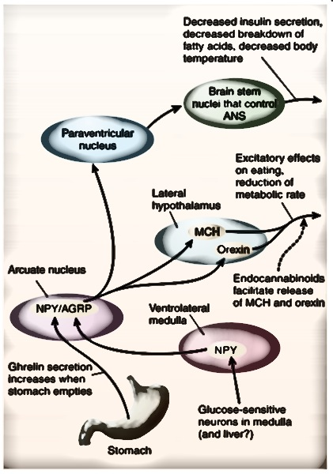
Hunger & Feeding Circuits
Carlson, Fig. 12.24

Slide 51
Feeding circuits II: satiety
PYY secreted after meal inhibits NPY/AGRP neurons.
Well-nourished fat cells secrete leptin and inhibit NPY/AGRP cells, excite α-MSH/CART neurons.
α-MSH/CART neurons project to lateral hypothalamus, inhibit MCH/Orexin neurons.
  Also inhibit PVN along with leptin.

Slide 52
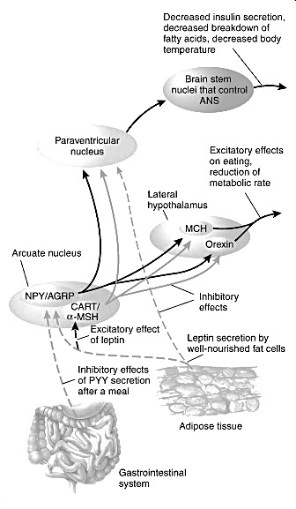
Satiety Circuitry
Carlson, 12.26

Slide 53
Obesity: Causes
Serious medical problem. Defined as BMI over 30.
Prevalence of 24.1% in Canada, 34.4% in USA (Statistics Canada, 2009). 67% of US men 62% of women are overweight.
Past 20 years: incidence of obesity has doubled (tripled for adolescents).

Slide 54
Obesity: causes?
Most obese people have elevated rather than low levels of leptin.
Researchers have suggested that a fall in blood levels of leptin should be regarded as a hunger signal.
  E.g. low level of leptin increases the release of orexigenic peptides and decreases the release of anorexigenic peptides.
Flier (1998): People with a thrifty metabolism should show resistance to a high level of leptin, which would permit weight gain in times of plenty.
People with a spendthrift metabolism should not show leptin resistance, and should eat less as their level of leptin rises.

Slide 55
Obesity: treatment
Surgeons have developed bariatric surgery to reduce amount of food that can be eaten during a meal, or interfere with absorption of calories from the intestines.
  aimed at the stomach, the small intestine, or both.
Most effective form of bariatric surgery is a special form of gastric bypass called the Roux-en-Y gastric bypass, or RYGB.
This procedure produces a small pouch in the upper end of the stomach.
The jejunum (second part of the small intestine, after the duodenum) is cut, and the upper end is attached to the stomach pouch.
Notes:
Figure 12.29 in text diagrams this nicely.

Slide 56
Treating Obesity: RYGB
One important reason for the success of the RYGB procedure appears to be that it disrupts the secretion of ghrelin.
The procedure also increases blood levels of PYY.
Both of these changes would be expected to decrease food intake: A decrease in ghrelin should reduce hunger, and an increase in PYY should increase satiety.

Slide 57
Caloric Restriction
Decades of remarkably consistent research shows that caloric restriction is associated with better health and longevity.
  Mice with balanced diet reduced by 65% had:
    Lowest incidence of cancers
    Best immune responses
    Greatest max lifespan (lived 67% longer than mice who ate as much as they liked).
  Positive health effects often not correlated with any weight loss (healthy often improves with caloric restriction even with no in body fat).
Notes:
Excessive energy consumption accelerates ageing independent of fat? (Lane et al., 2002).

Slide 58
Eating Disorders
Anorexia Nervosa: Eat too little, to the point of starvation.
  Intense fear of becoming obese.
Bulimia Nervosa: Loss of control of food intake.
  Periodic binging and purging.

Slide 59
Anorexia & Bulimia
Anorexia is can be deadly.
  - Five to ten percent of people with anorexia die of complications of the disease or of suicide. Many anorexics suffer from osteoporosis, and bone fractures are common.
When the weight loss becomes severe enough, anorexic women cease menstruating.
Some cases indicate the presence of enlarged ventricles and widened sulci in the brains of anorexic patients, which indicate shrinkage of brain tissue.

Slide 60
Anorexia: Causes
Blood levels of NPY are elevated in patients with anorexia.
  infusion of NPY into the cerebral ventricles further increased the time spent running in rats on a restricted feeding schedule.
Normally, NPY stimulates eating (as it does in rats with unlimited access to food), but under conditions of starvation, it stimulates wheel-running activity instead.
The likely explanation for this phenomenon is that if food is not present, NPY increases the animals’ activity level, which would normally increase the likelihood that they would find food.

Slide 61
Applied example: 5-HT & Satiety
A long line of studies show that hypothalamic (5-HT) plays a role in satiety. This satiety has two properties:
Causes rats to resist powerful attraction of highly palatable diets.
Reduced amount of food consumed per meal, rather than reducing number of meals.
Notes:
SSRIs reduce hunger, eating, and BW.
Caf diet: bread & chocolate.

Slide 62
5-HT reduces carb ingestion
Tryptophan is a precursor of 5-HT, and increases in brain tryptophan lead to increases in brain 5-HT.
Increase in brain 5-HT leads to decreased consumption of carbohydrates.
  Carb consumption, insulin injection, and tryptophan levels all increase brain 5-HT.
  5-HT agonists decrease carb intake.
  These effects are not seen for peripheral 5-HT admin. (why might that be?)
Notes:
Tryp->5-Htryp->5-HT.
Hint: think enzymes…

Slide 63
5-HT model of macronutrient selection
Carbohydrate-rich meals increase glucose, insulin, leptin, and cort levels, activating 5-HT neurons projecting to the medial hypothalamus.
  These neurons inhibit NPY release.
Activation of these neurons leads to 5-HT synthesis + release, which terminates carb ingestion, leading to satiety.
Notes:
5-HT1B,C -R subtypes, for the insanely detail -oriented.

Slide 64
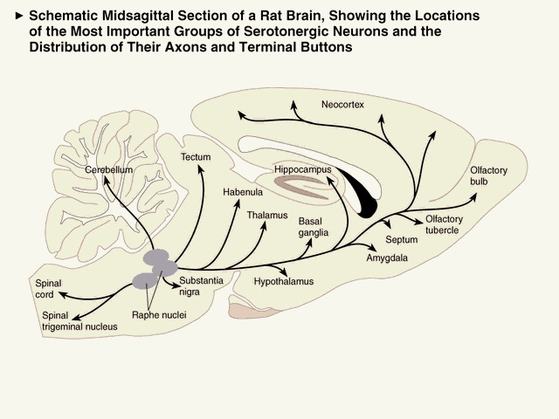
5-HT pathways
Fig. 4.17

Slide 65
Logic of 5-HT role in macronutrient selection
A high-carb diet leads to ⬆ circulating tryptophan (TRP).
Promotes uptake of TRP into brain, conversion into 5-HT.
⬇ concentrations of other amino acids that compete with TRP for transport into brain.
Notes:
LNAAs and TRP compete for BBB passage across LNAA transporter (which carries branched-chain AAs (Valine, Leucine, Isoleucine) and aromatic (TRP, TYR) AAs. Transport is rate-limiting step in blood-brain tissue movement of aas.
Tryptophan-> 5-hydroxytriptophan-> 5-hydroxytriptamine (fig 4.16)
Insulin promotes use of LNAAs by skeletal muscles, leaving relatively more TRP to cross BBB
5-HT neurons project from Raphe to

Slide 66
5-HT, Carbs & Satiety
Insulin stimulates Absorption of Large Neutral Amino Acids (LNAAs), increasing ratio of TRP:LNAAs that cross BBB.
More 5-HT release in hypothalamus = decreased carb ingestion, satiety.
Notes:
Insulin presence shunts LNAAs to muscles, allowing more tryp relative to LNAAs than usual to cross bbb. More 5HT = less NPY release.

Slide 67
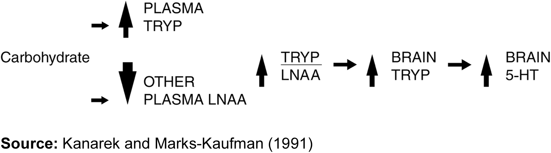
Summary

Slide 68
The last word…s
Neural control of hunger, eating, and satiety is a complex, redundant system involving many peptides and transmitter systems (see table 12.1)
Hunger and eating are heavily influenced by sensory stimuli, learning, and classical conditioning. These factors are more likely to start a meal than a true energy deficit.
Circuits within the hypothalamus are critical to initiating and terminating ingestive behaviour.

